Slide 1






SESSION 3
Implemented by:
Unlocking Finance: An Integrated Approach to Accelerate the Flow of Funds for Energy Efficiency Investments
Project Driven Facilitation & Stakeholder Engagement
Rashindu Mendis

Slide 2






Challenges in Unlocking and Mobilizing Private Financing
Solutions
1. Lack of technical capacity to identify and quantify energy saving opportunities
2. Lack of awareness on the demand side (industrial sector companies) about the economic and environmental benefits of industrial decarbonization
3. Lack of capacities of financial institutions when it comes to structuring financial products as well as understanding and assessing project risks
1.Capacity building - for industries
2.Technical support
3.Pilot projects
1. Capacity building - for banks
2. Pilot projects
Implemented by:
Image: Michel Tcherevkoff/Getty Image
Notes:
I believe most of you have seen this image. This is a meme on the internet.
You might wonder how this image is related to financing or decarbonisation. Let me explain.
Among many other reasons……
This EU funded project has taken many steps

Slide 3

Training Programmes for Industries - Energy
ISO50001 compliant Energy Management Systems (EnMS)
              Launched in October 2022. Completed 2 successful batches. 3rd batch is ongoing
            Over 190 local experts have been trained so far
            Over 65 factories have benefited from the programme
            8 factories are ISO 50001 certified. Few more are in the pipeline.
Energy Systems Optimization (ESO)
Steam systems - 1st batch was delivered in 2024, 2nd batch is ongoing
Motor systems - 1st batch was delivered in 2024, 2nd batch is ongoing
Pump systems - ongoing (Expert level training in July 2024)
Compressed-air systems - Scheduled for August 2025 (Applications are now open)
Chiller and refrigeration systems - Scheduled for 2026
Renewable Energy System Design (RE)
Solar PV - Scheduled for August 2025
Biogas - Scheduled for 2026
Solar PV Train-the-trainer programme was delivered to the Instructors of the VTA
Implemented by:
Notes:
Tried tested and proven in many countries
International UNIDO experts
EnMS and ESO should go hand-in-hand
ESO is where the real savings are

Slide 4






























































































Participant Industries
Implemented by:
4
Notes:
Common factor: majority are energy intensive, export oriented large enterprises
If you look closely, you will notice that most of the companies belong to 3 industry sub-sectors
Textile and apparel, food and beverage, plastics and rubber.
These 3 sub sectors account for almost 50% of the total industry sector energy consumption

Slide 5

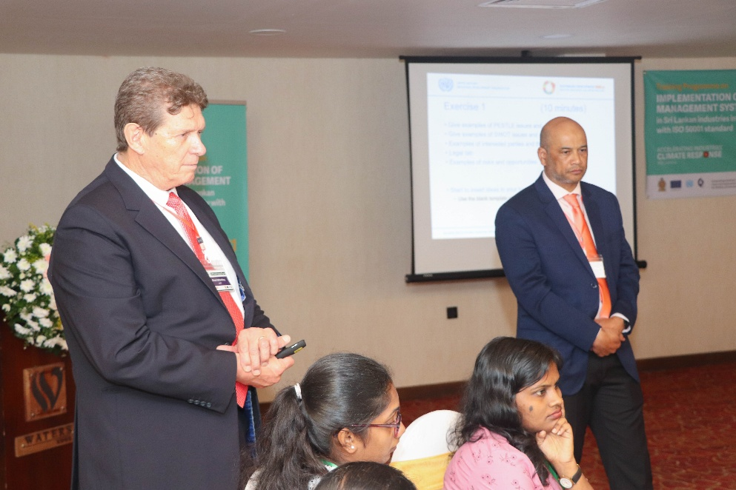
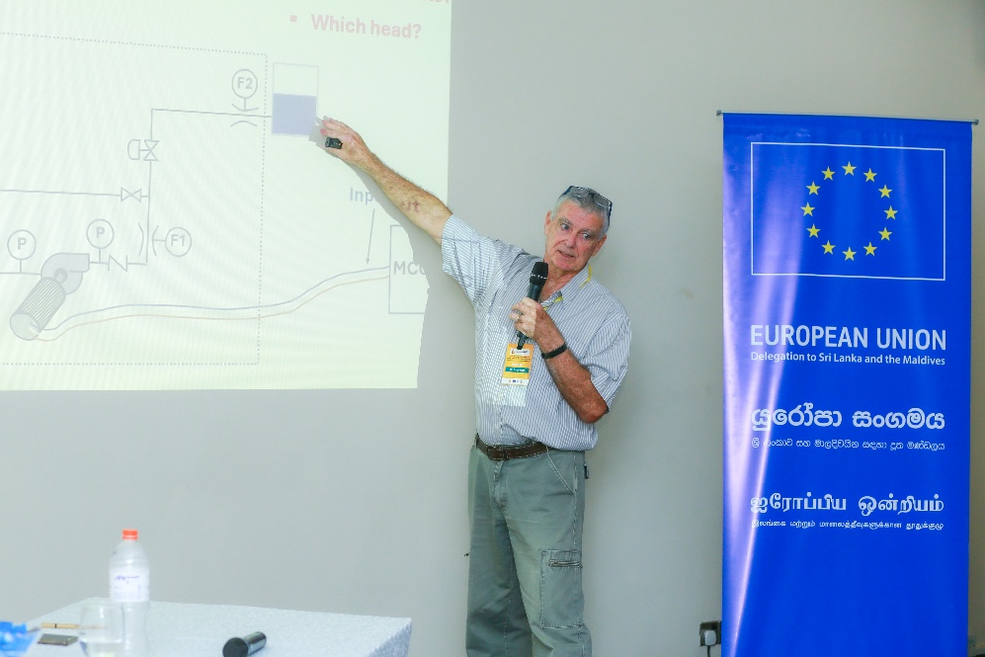
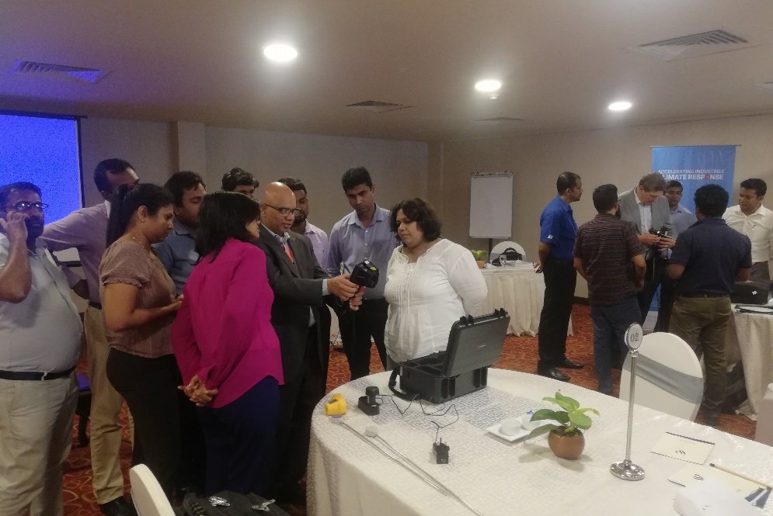
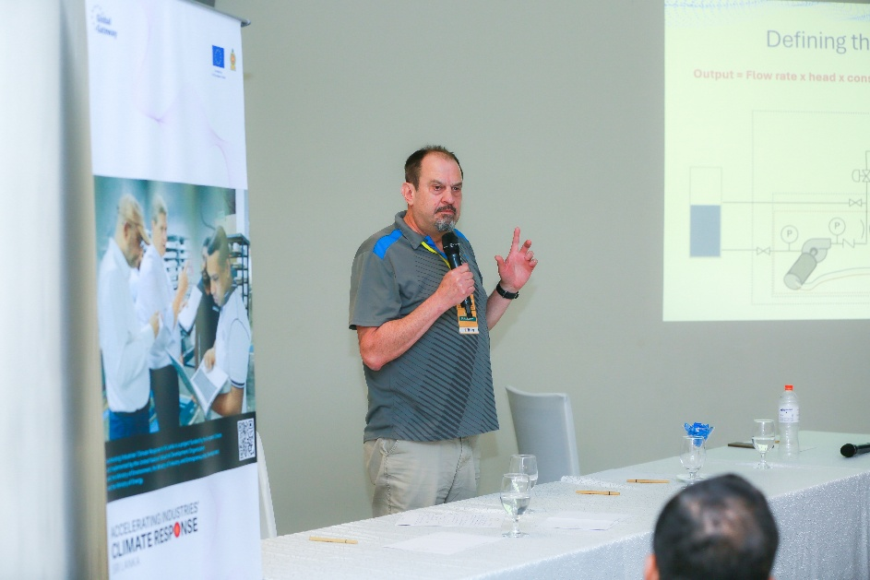
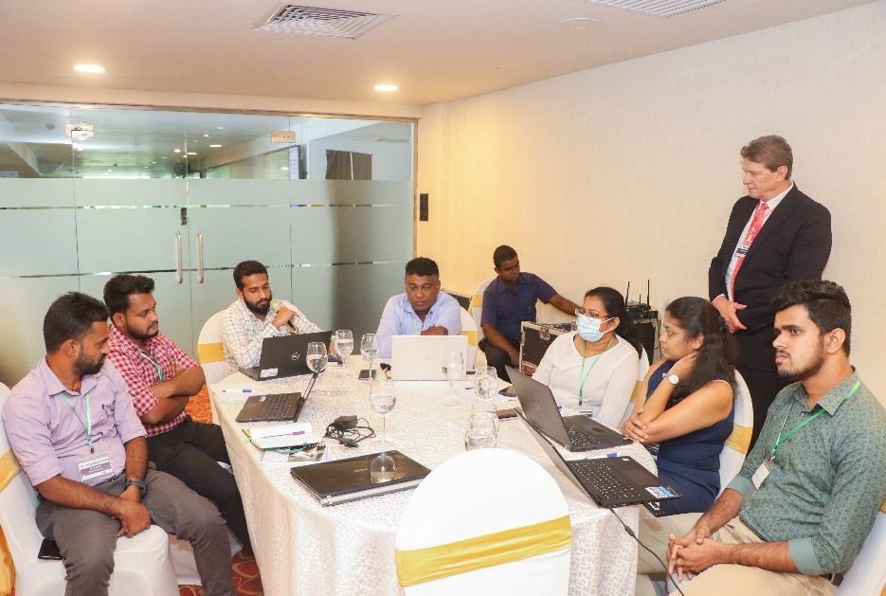
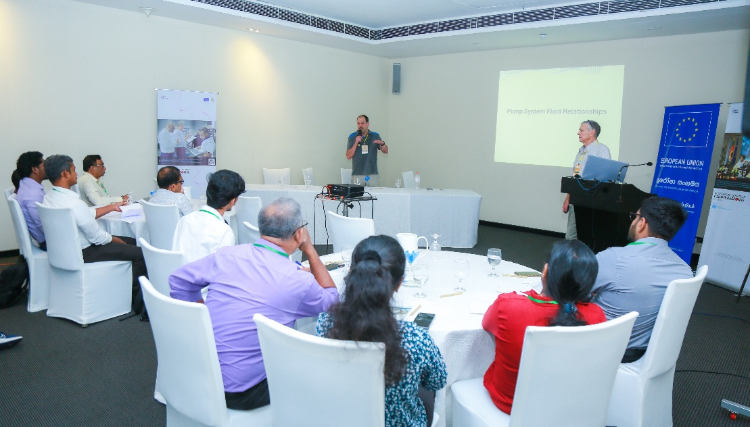
Implemented by:
5
Notes:
Mix of classroom sessions and practical sessions
UNIDO international experts took the initiative.
But gradually transformed the knowledge and skills to local experts. Trained local experts now co-deliver trainings together with international experts
EnMS runs for a whole year. ESO runs for about 9 months.

Slide 6
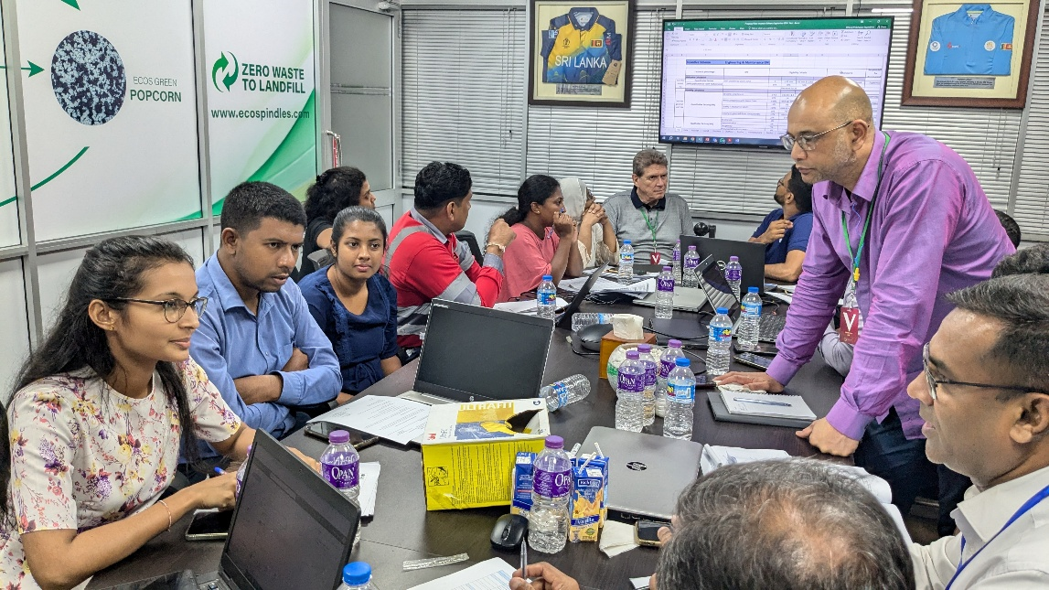
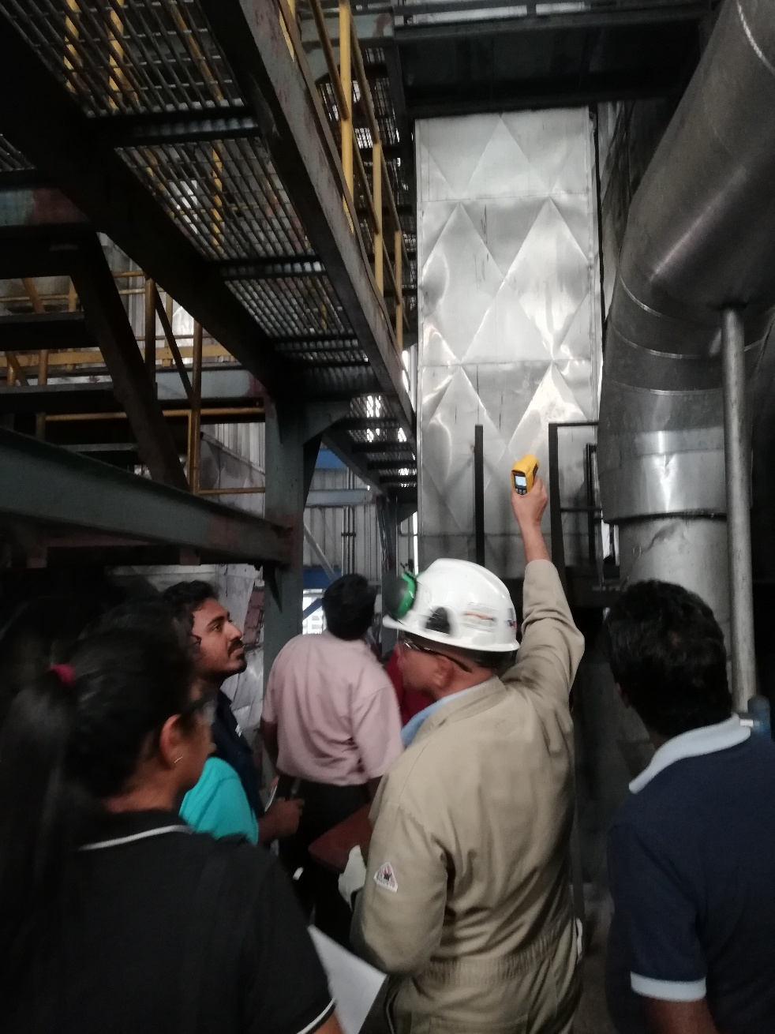
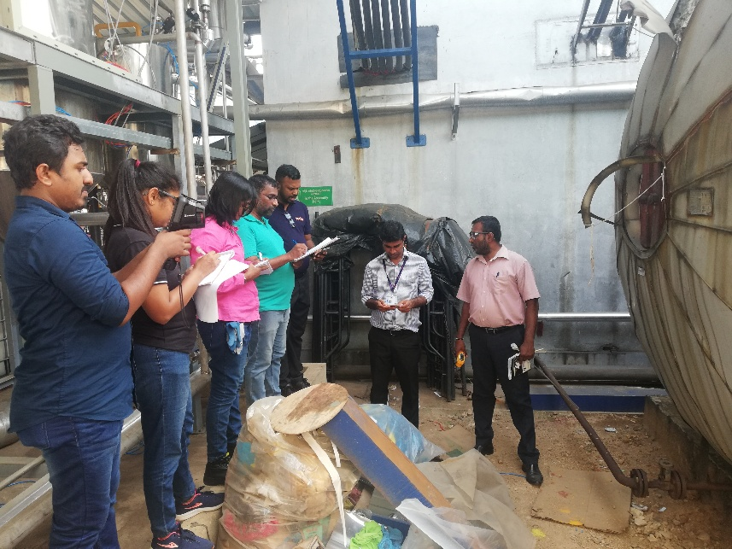
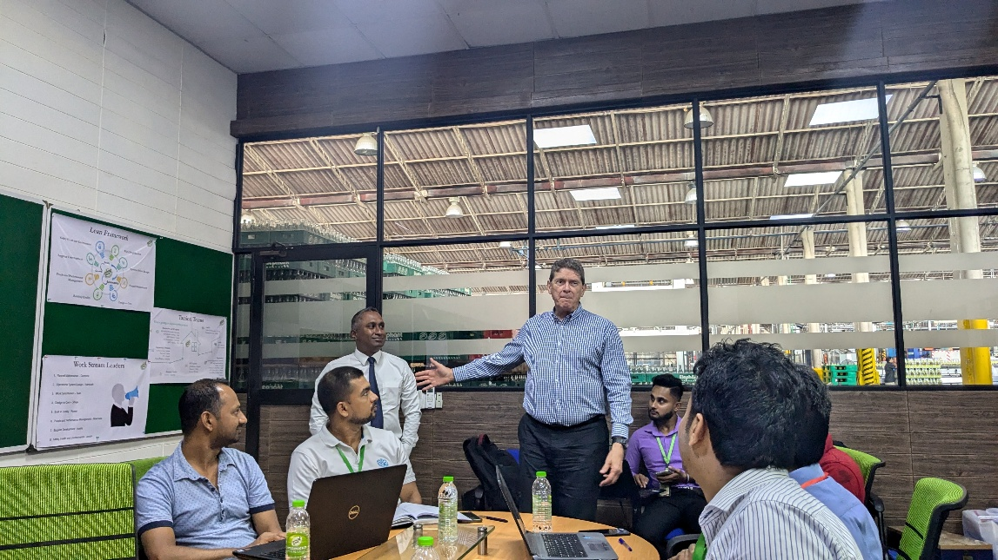
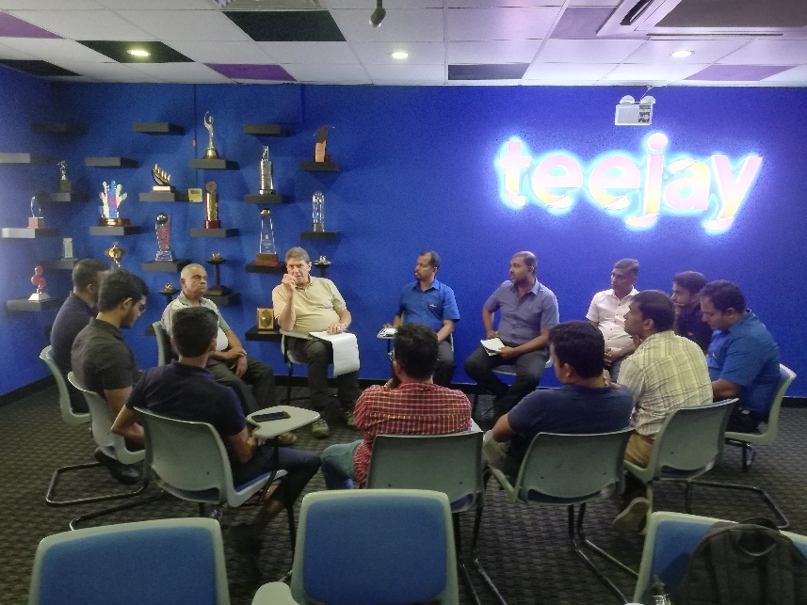
Implemented by:
6
Notes:
In practical sessions, the participants visit a factory which is know as the host plant, and do an actual on-site assessment under the guidance of the international experts
For EnMS it is an internal audit. For ESO it is an assessment using advance measuring equipment and instruments

Slide 7
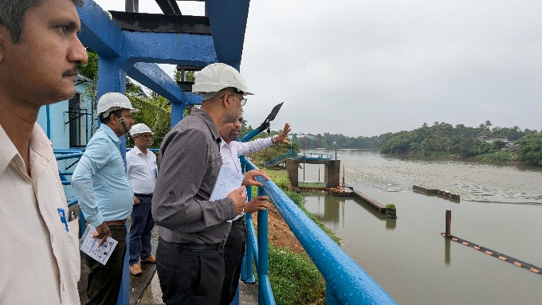
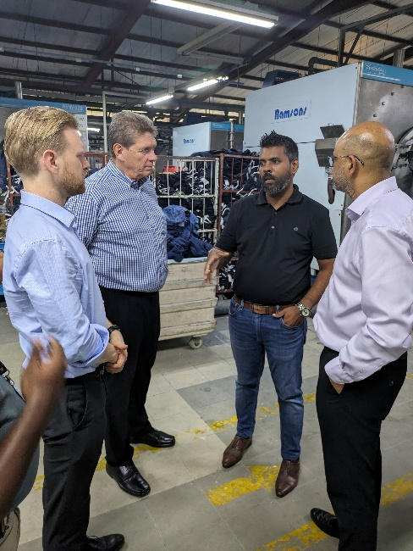
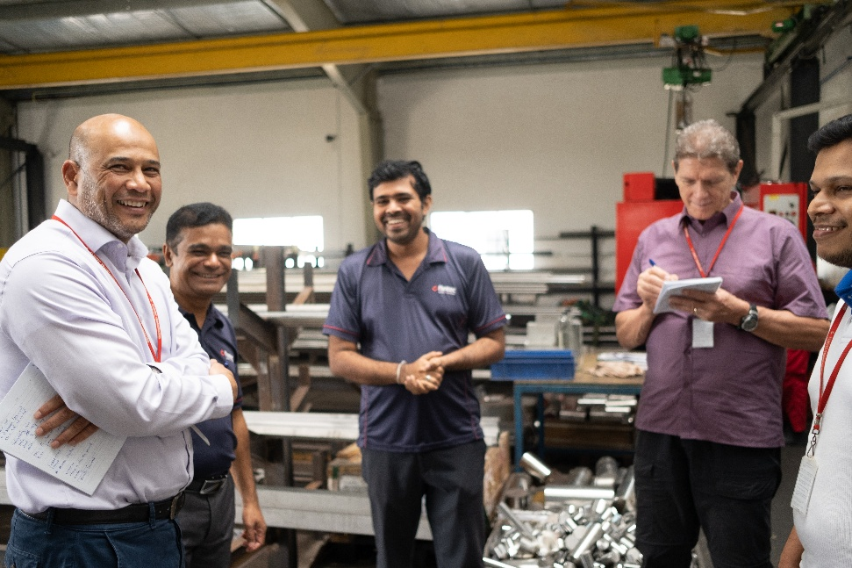
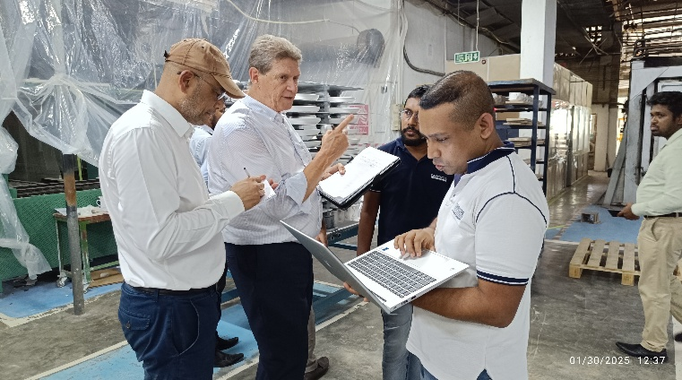
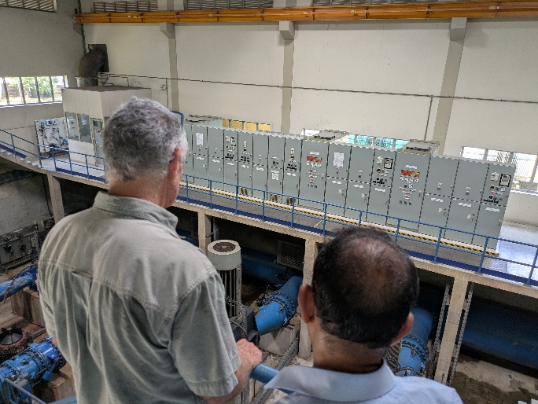
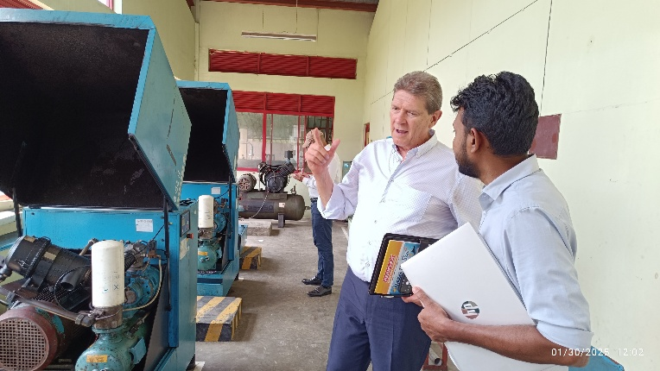
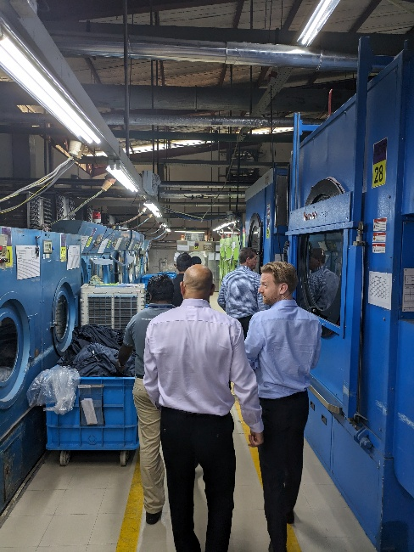
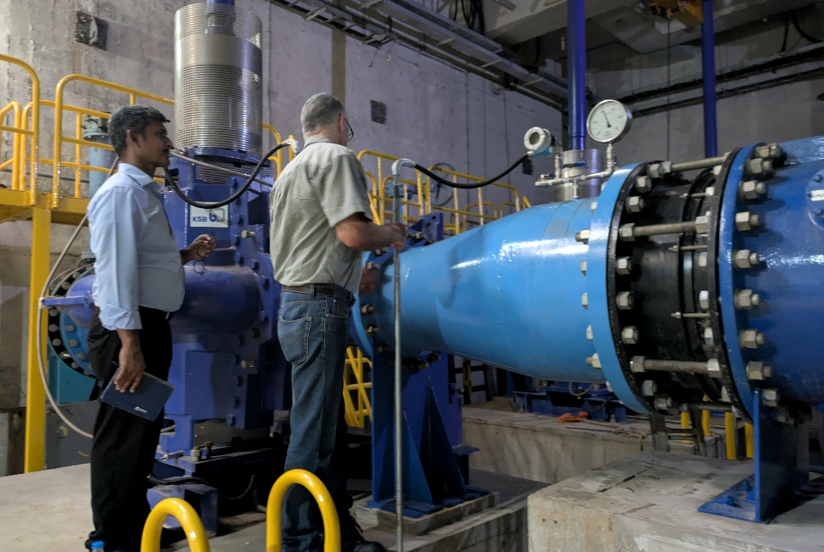
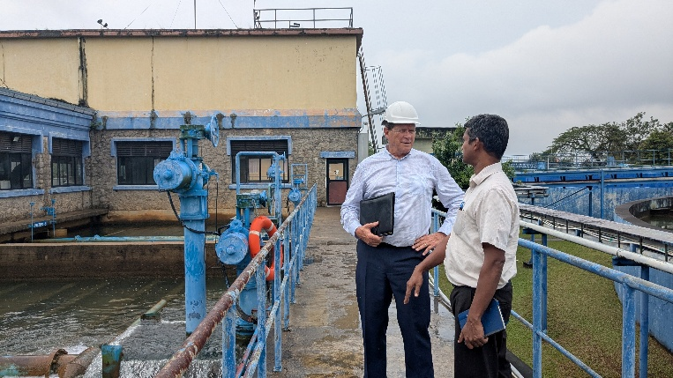
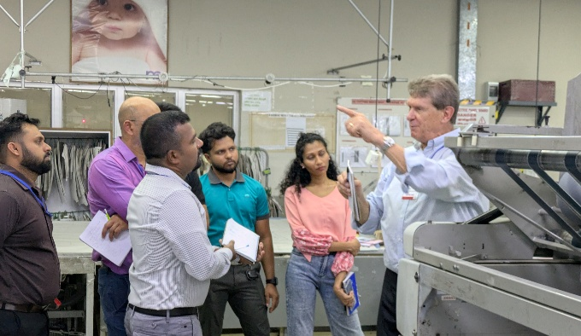
Implemented by:
7
Notes:
We didn’t stop there. We took another step forward.
The experts visited a number of selected plants as we call candidate plants. There we sat with the top management of the respective organization, and also the technical team.
One key benefit of the visits was top management commitment. Through that we were able to get recognition credibility and support to the participants of the training
Further, initial saving opportunities were also identified
Continuous technical support is being provided

Slide 8
Training Programmes for Industries - Finance
Training Workshop on Sustainable Finance and Development of Bankable Business Proposals for Industries
    1st round was delivered in 2024
    Target audience:
      Medium and large industries who are willing to get funding for energy efficiency projects from banks (Energy, Operations, Financial and Business Managers)
      Industry Associations (Technical and Financial Advisors e.g. Chamber of Industries)
      Technology service providers such as ESCOs
    Toolkit with business case template was introduced
    Financial sources database and EE project database were introduced
    Target: 80 bankable business proposals
    2nd round will be delivered in 2025
Implemented by:

Slide 9
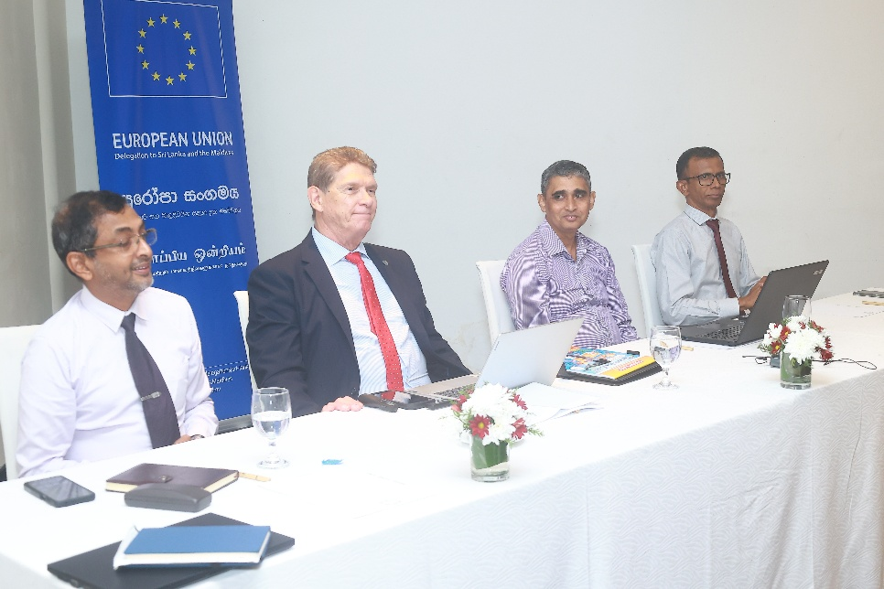
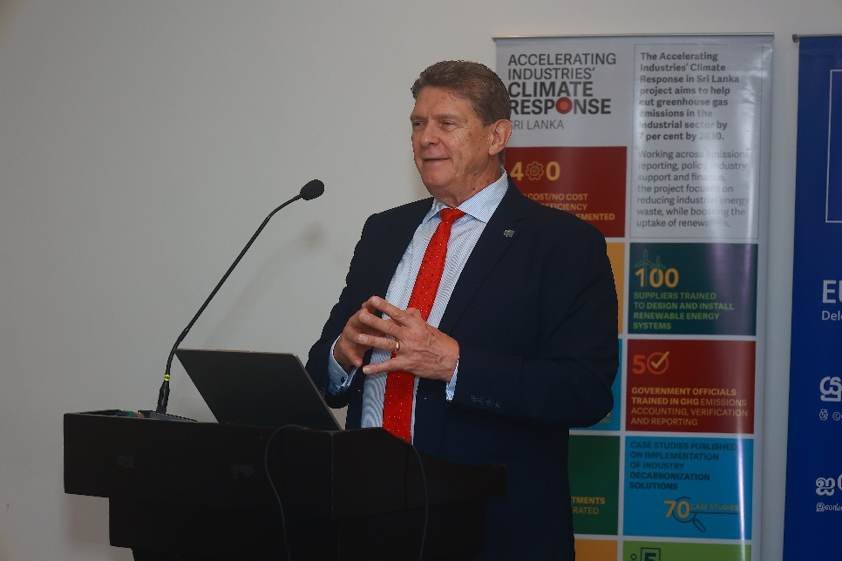
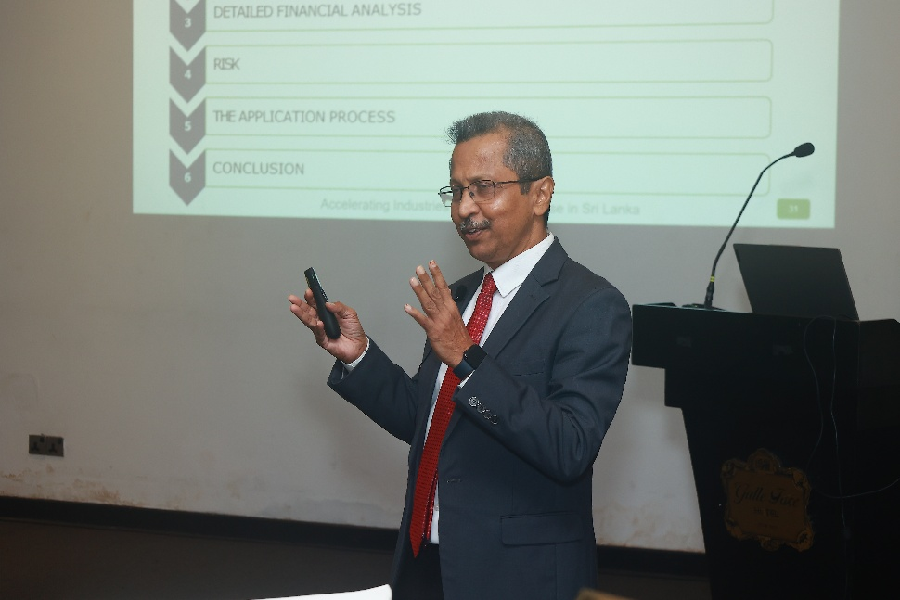
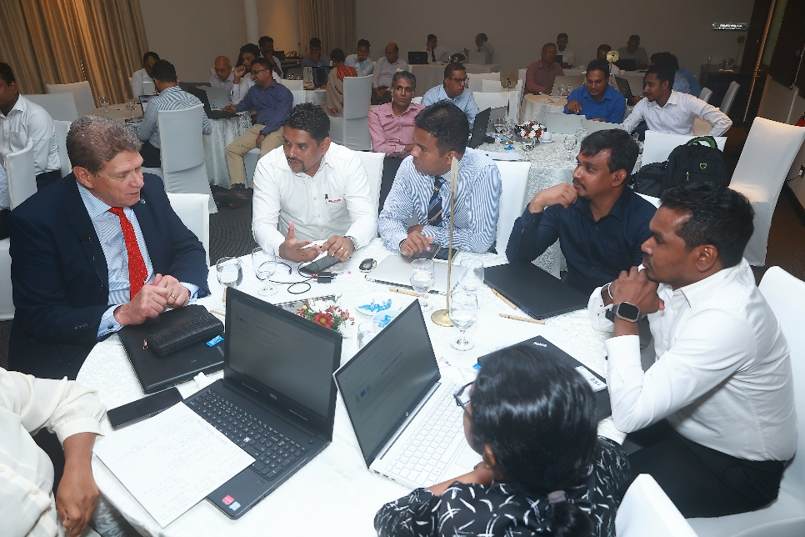
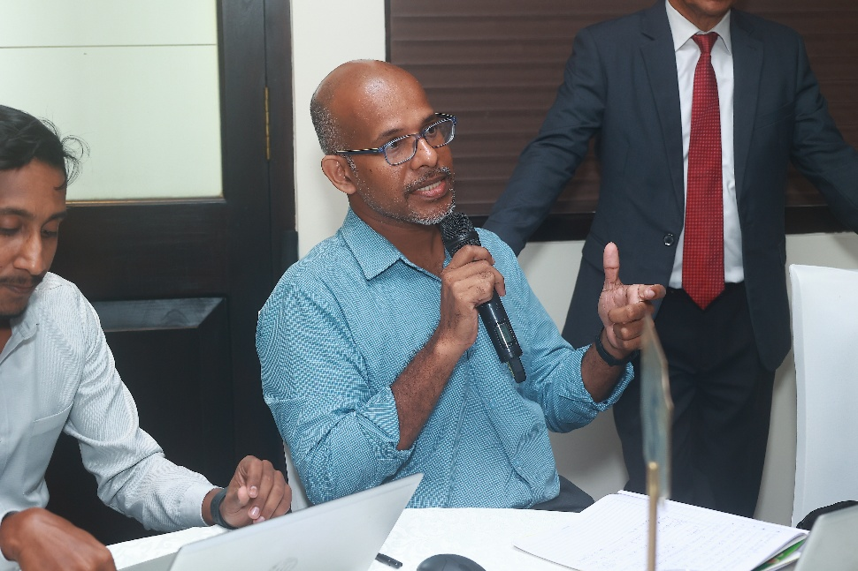
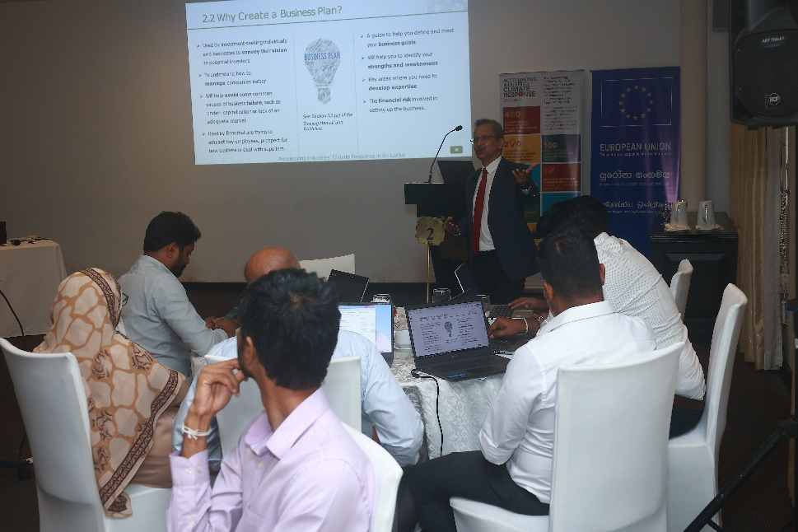
Implemented by:
9
Notes:
Both technical and financial staff participated
This training was delivered by both national and international experts.
We are closely monitoring progress of the projects identified by the industries.

Slide 10
Training Programmes for Banks
Renewable Energy Awareness Programme for Policymakers and Bankers
    First round was delivered in 2023/24
    Target audience:
      Policymakers (ministries and other relevant organizations)
      Bankers
    Topics: Solar PV, solar thermal, bigas and biomass
    Consisted of classroom sessions and site visits
    2nd round will be delivered in 2025
Implemented by:

Slide 11
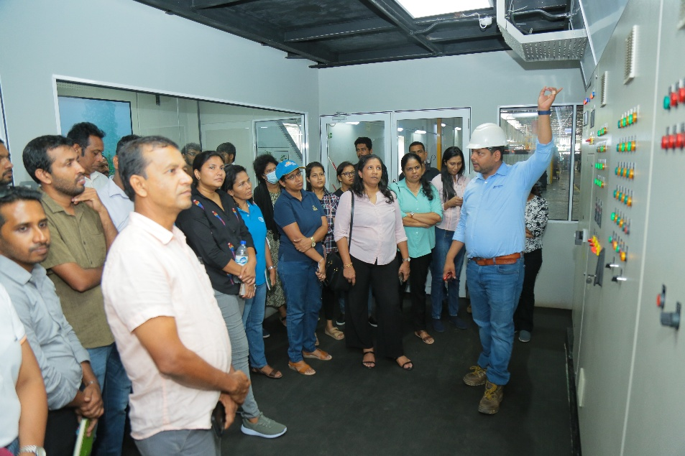

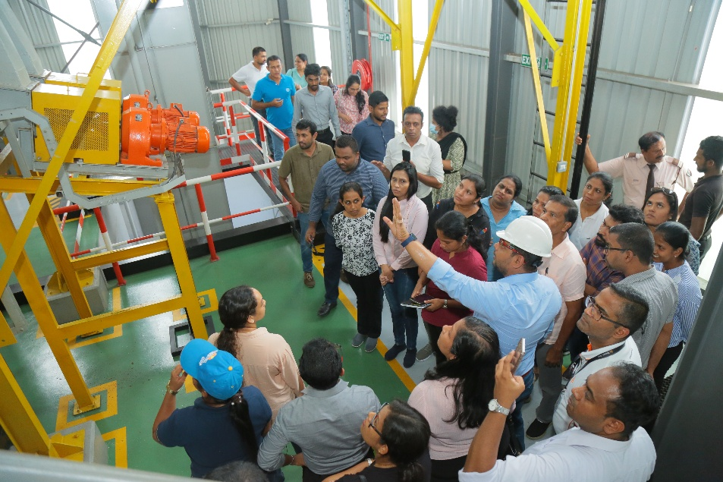
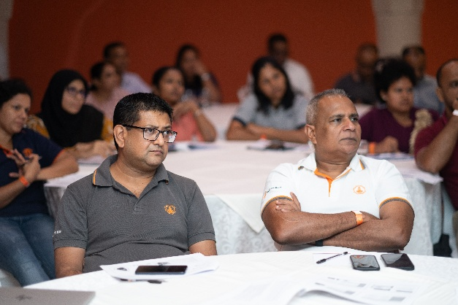
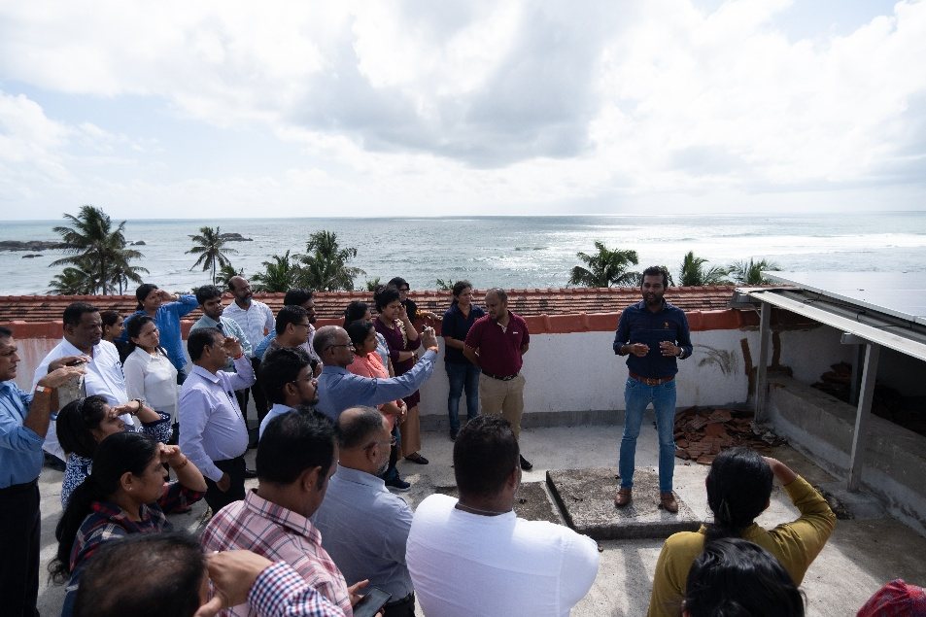
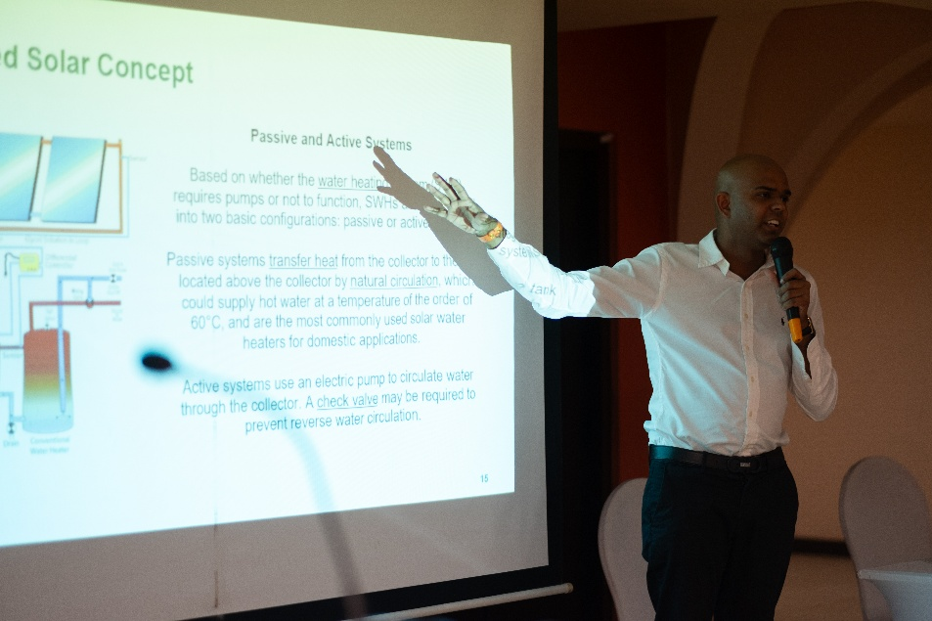
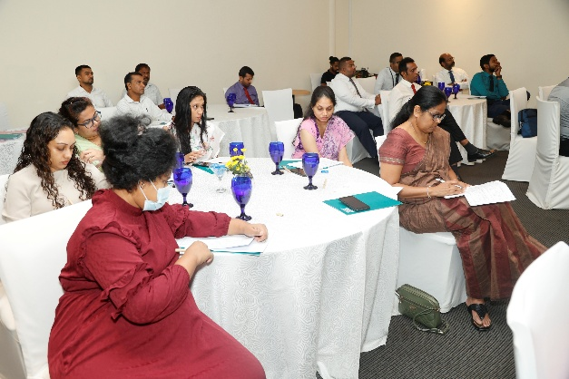
Implemented by:
11

Slide 12
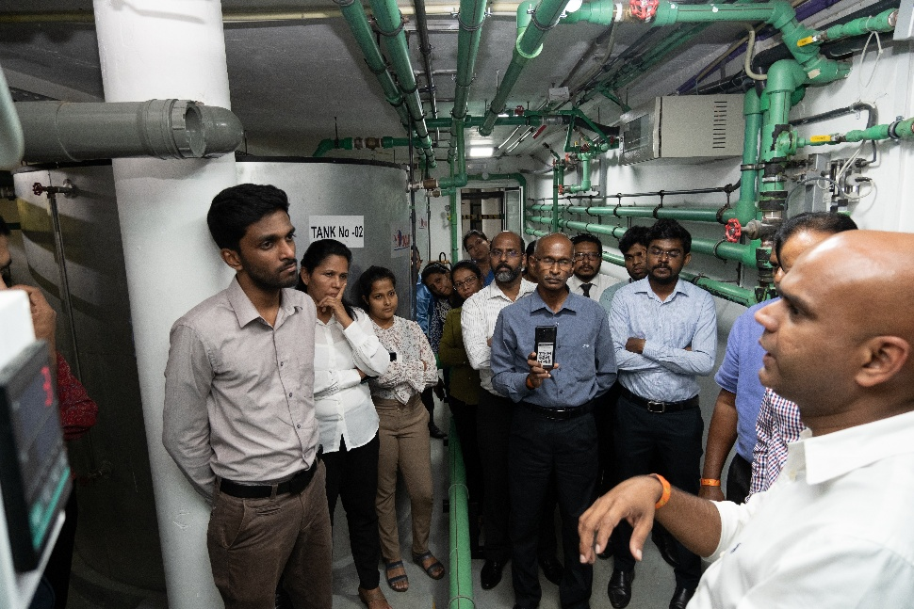

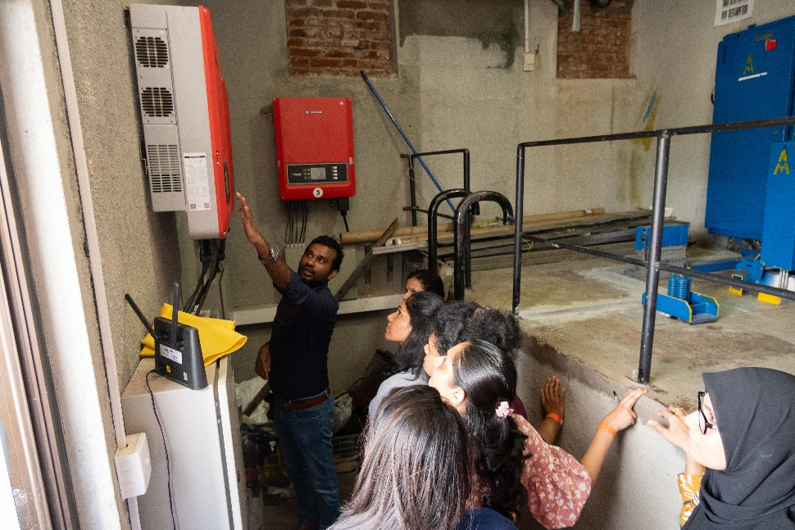
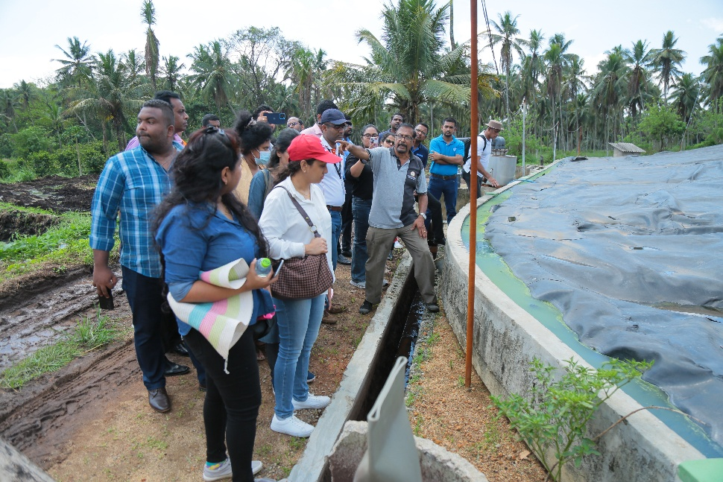
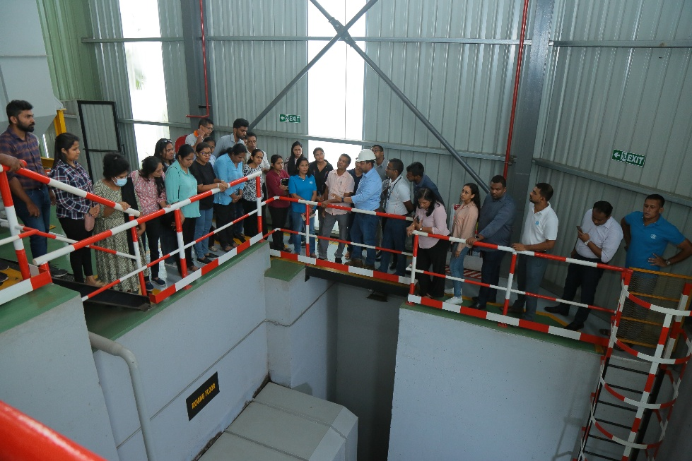

Implemented by:
12

Slide 13
Training Programmes for Banks
Capacity Building Session on Sustainable Finance for Banks
    1st round was delivered in 2024
    Target audience:
      Senior staff
      Operational level staff
    Key learnings:
      How to structure low-carbon project financing transactions more efficiently
      How to identify and avoid inherent technical or contractual risks
      How to draft and analyse multi-year project cashflows
    The programme is now being revised. The 2nd round will be delivered in 2025
Implemented by:

Slide 14
Low-carbon Technology Pilot Projects
10 low-carbon projects will be funded/ co-funded
6 projects have been identified so far through EnMS and ESO programmes
Technical specifications are being prepared to start procurement
These projects will be excellent case studies on how high-cost EE projects could benefit the industries in terms of energy savings, GHG savings, return on investment and assessing project risks
Implemented by:

Slide 15
Low-carbon Technology Pilot Projects
Pillar of Decarbonization | Technologies
Energy efficiency | High efficiency motors Variable speed drives Economizers Advanced boiler control systems
Electrification | Electric boilers Industrial heat pumps Alternative processes with electrified heating
Low-carbon fuels, feed stocks and energy sources | Solar PV Solar thermal Sustainable biogas Sustainable biomass
Selection criteria:
Impact
Innovativeness
Diversity
Financing
Sustainability and reporting
Implemented by:

Slide 16

Goal: Bridge the Gap Between Industries and Banks
Implemented by:
Image: DRB Development Solutions

Slide 17



Industries
Banks
Industries are aware about economic benefits of industrial decarbonization.
Industries have technical capacity to identify and quantify energy saving opportunities.
Industries know how to prepare bankable business proposals for decarbonization projects.
Savings, financial benefits and risk mitigation strategies are demonstrated by pilot projects.
Banks have basic technical knowledge on industrial decarbonization solutions.
Banks have technical capacity to quantify energy saving opportunities.
Banks know how to evaluate bankable business proposals on decarbonization projects.
Savings, financial benefits and risk mitigation strategies are demonstrated by pilot projects.
Implemented by:
Image: DRB Development Solutions

