Slide 1






SESSION 2 PRESENTATION
Implemented by:
Industry Sector Energy Usage and GHG Emissions
Dr. Jagathdeva Vidanagama

Slide 2


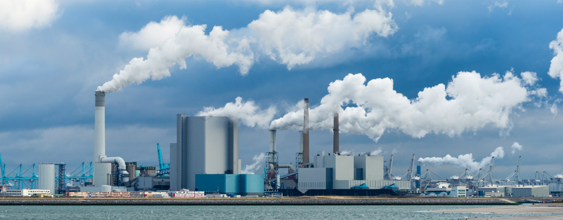


Implemented by:
Industry Sector GHG Emissions
GHG Emissions sources according to the IPCC Methodologies
Energy
Industrial Processes and Product Use
(IPPU)
Waste
Management

Slide 3
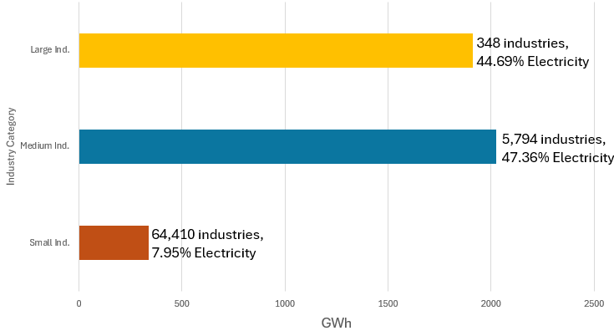
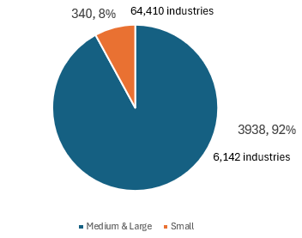
Implemented by:
Industry Sector Electricity Consumption (GWh)
340 GWh, 8%
3,938 GWh, 92%
CEB Statistical Digest, 2023

Slide 4

Industry Sub Sector Electricity Consumption (GWh)
Food & Beverage (2,022 Ind.) 21.18%
Textile and Apparel (662 Ind.) 15.76%
Plastic and Rubber (441 Ind.) 8.84%
Refinery and Chemical (255 Ind.) 7.06%
Metal (261 Ind.) 7.39%
Non-Metallic Mineral (233 Ind.) 7.24%
National Water Supply & Drainage Boad 7.85%
Other
25%
CEB, SLSEA, 2023
Implemented by:

Slide 5
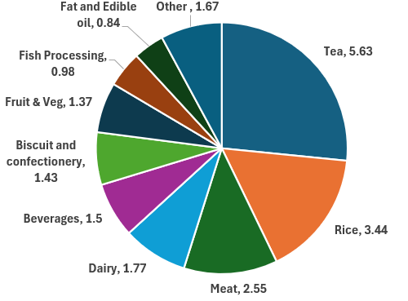
Food and Beverage Sector
(out of 21.18%)
Implemented by:

Slide 6
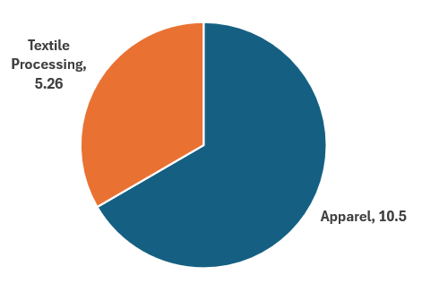
Textile and Apparel sector (out of 15.76%)
Implemented by:

Slide 7
Tea Sector Energy Share Estimation
(2,287,081 MWh)
Implemented by:

Slide 8
Textile Processing Sector Energy Share Estimation (710,509 MWh)
Implemented by:

Slide 9
Apparel Sector Energy Share Estimation
(931,677 MWh)
Implemented by:

Slide 10
Rubber (tire) Sector Energy Share Estimation
(210,847 MWh)
Implemented by:

Slide 11
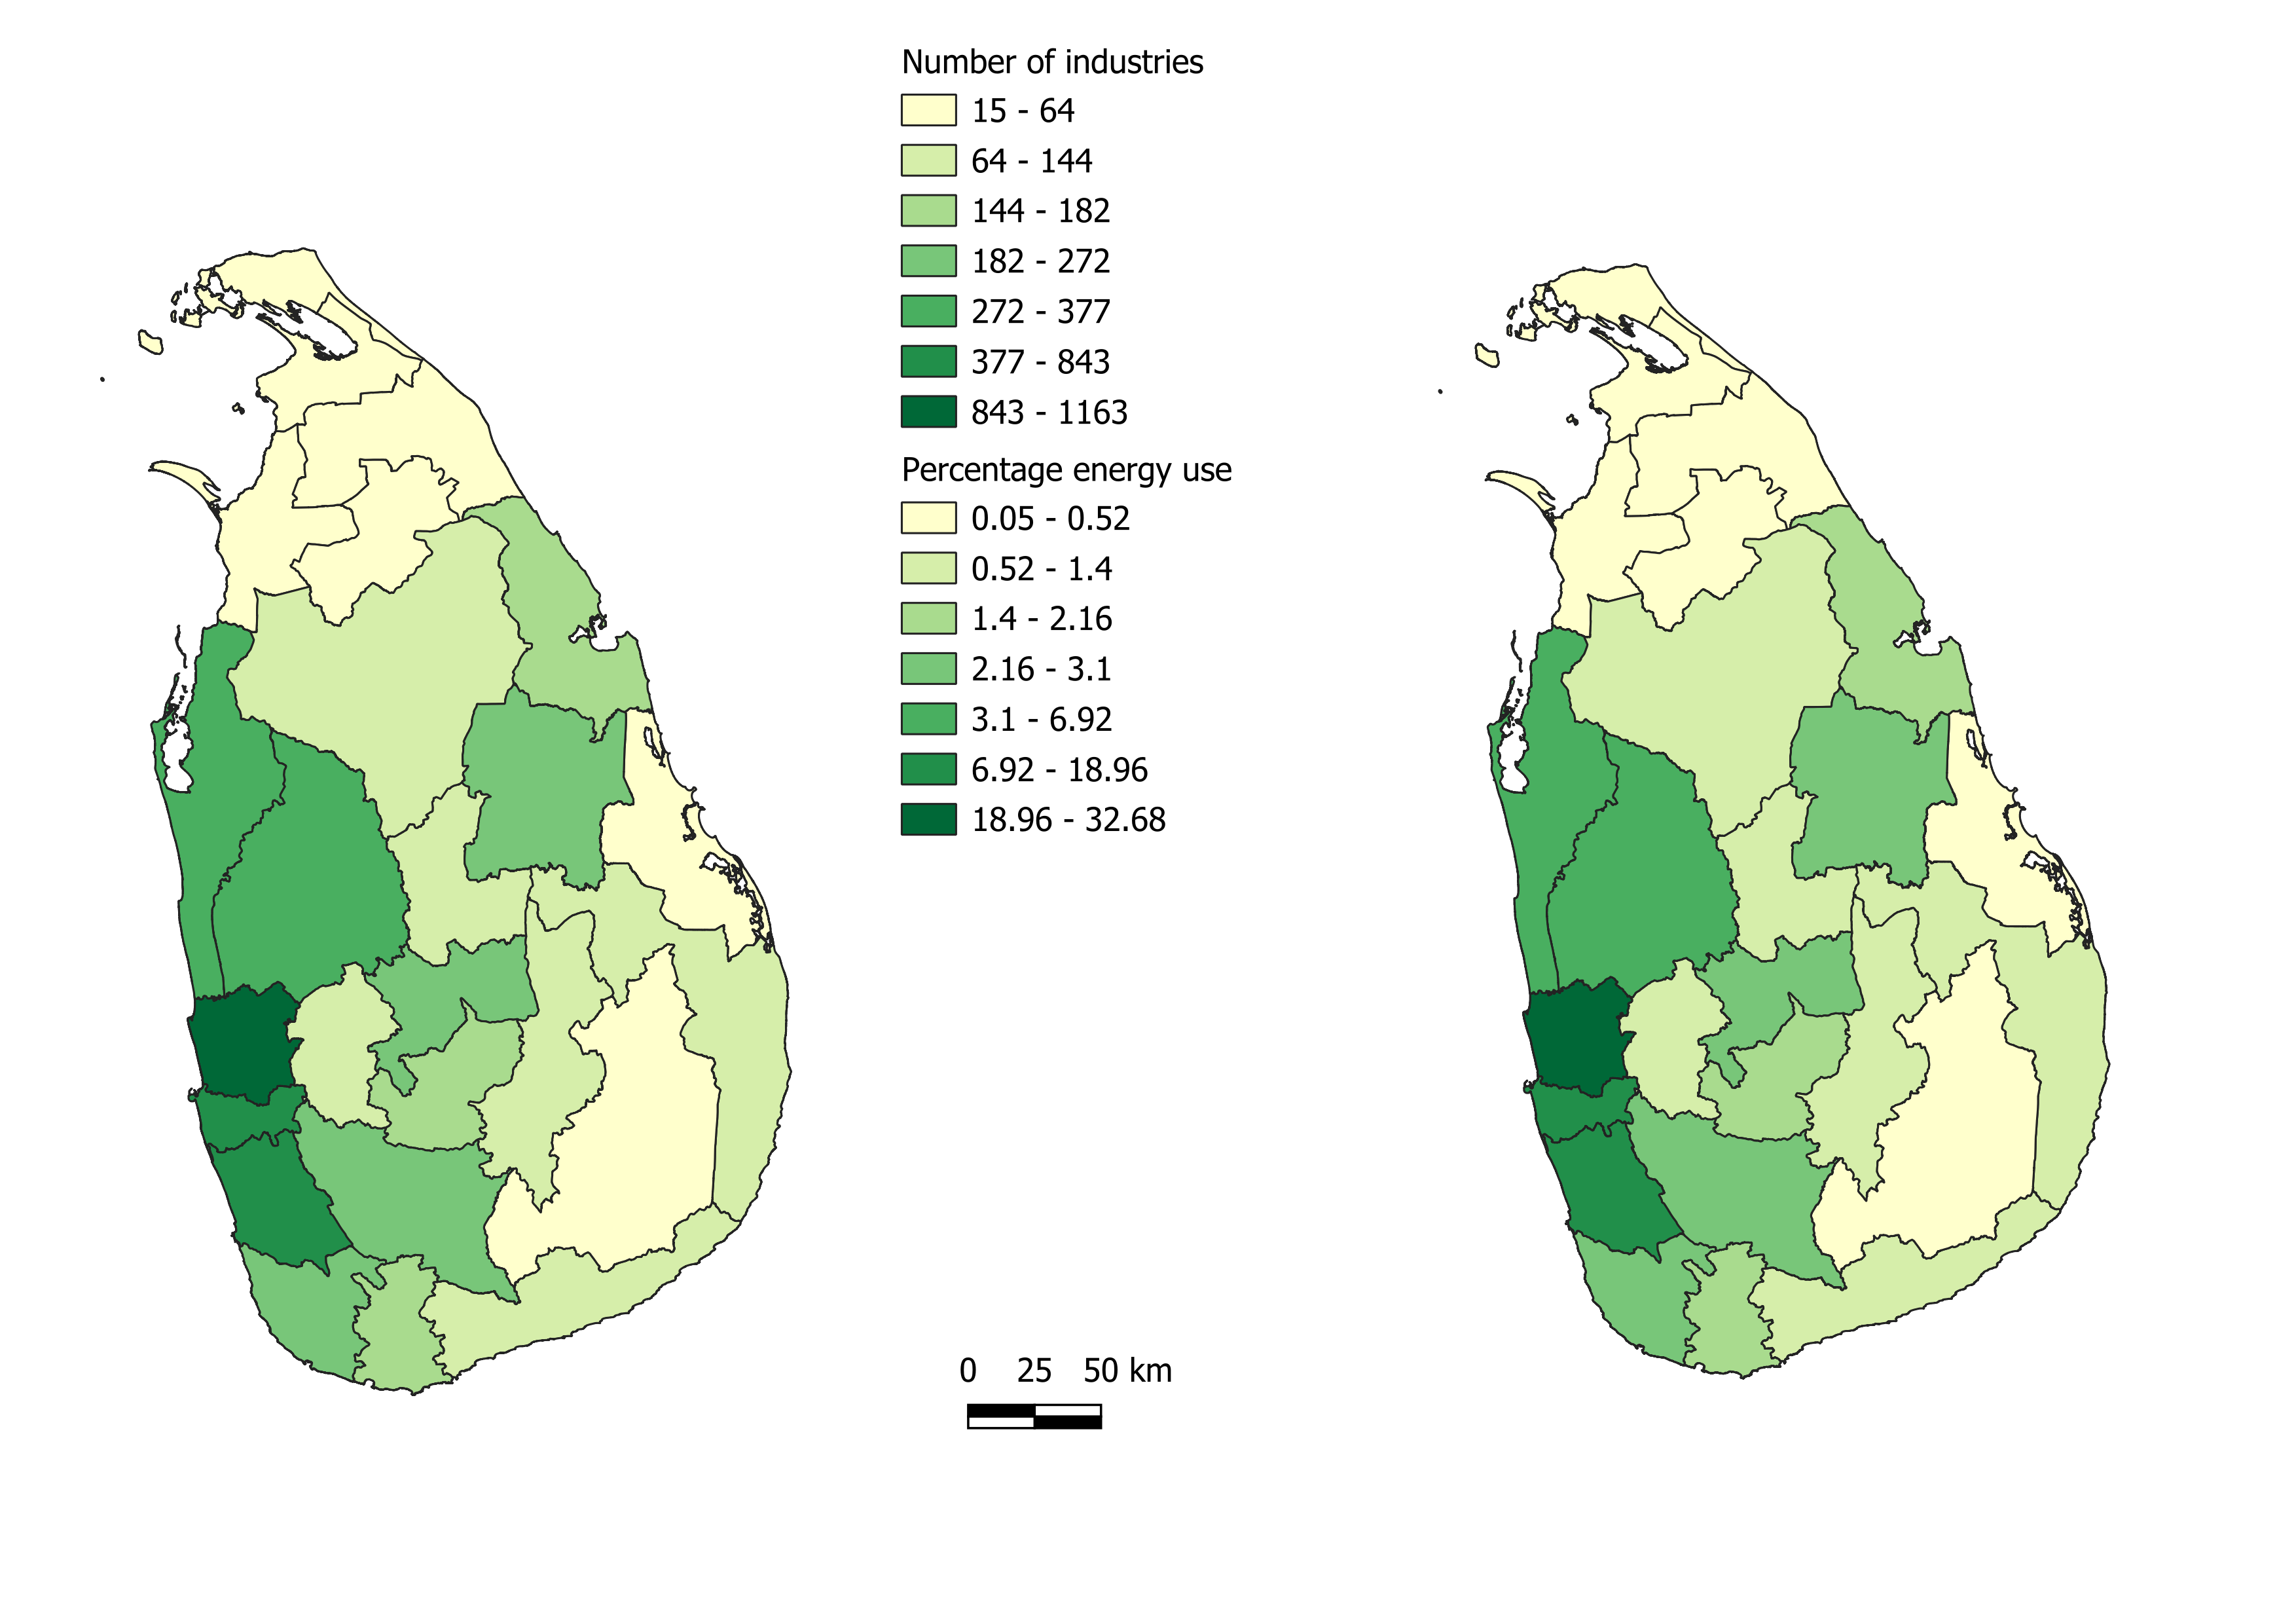


Implemented by:
Number of Industries by District
Industry Sector Electricity Usage Percentage
by District

Slide 12
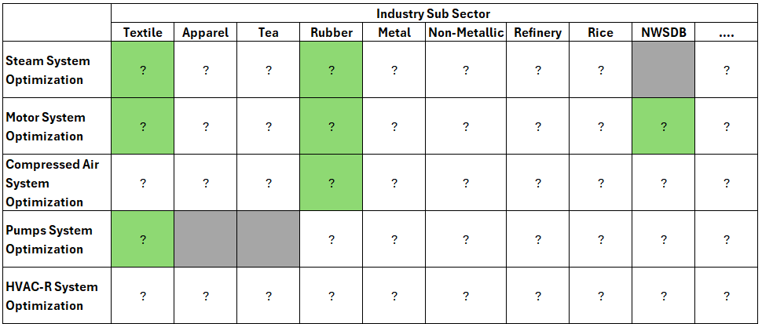
Energy Efficiency Potential
Implemented by:

Slide 13
Thank you
Implemented by:

