Slide 1






SESSION 1 PRESENTATION
Implemented by:
Sri Lanka’s National Climate Action Pathway
K.N. Kumudini Vidyalankara
Director( Environment Planning and Economics)
Ministry of Environment

Slide 2



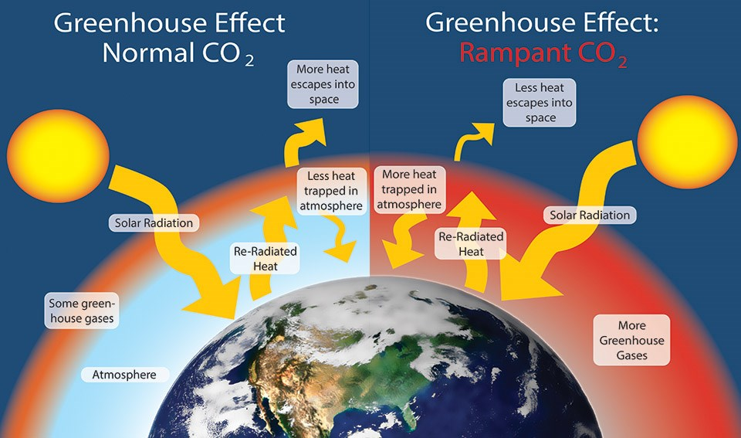


Implemented by:
Climate Change
Climate Change
Prolong Droughts
Flash floods
Hurricanes
Storms
Changing Climate Systems
Global warming
Increased GHG Concentration in the atmosphere
Burning Fossil fuels
Industrial Process
Waste
Land uses
Human Activities

Slide 3
Implemented by:
UNFCCC 1992
Kyoto Protocol
1997
Paris Agreement
Sri Lanka, A party to the Paris Agreement
First NDCs 2016; NDCs-2 202; NDCs-3 2025
ETS
Joint Mechanism
CDM
Nationally Determined Contributions
Actions taken by the Parties to reduce GHG emissions
and adapting the adverse impacts of climate change

Slide 4

Mitigation NDCs
Forestry
Industry
Electricity
Transport
Waste
Agriculture
Implemented by:

Slide 5
Implemented by:
Commitment to global climate goals: Paris Temperature goal
Environmental Benefits: Emission Reduction, climate change adaptation
Economic Opportunities Green jobs creation, Investment opportunities
Why?
Why we should Prepare, submit
and implement NDCs?

Slide 6
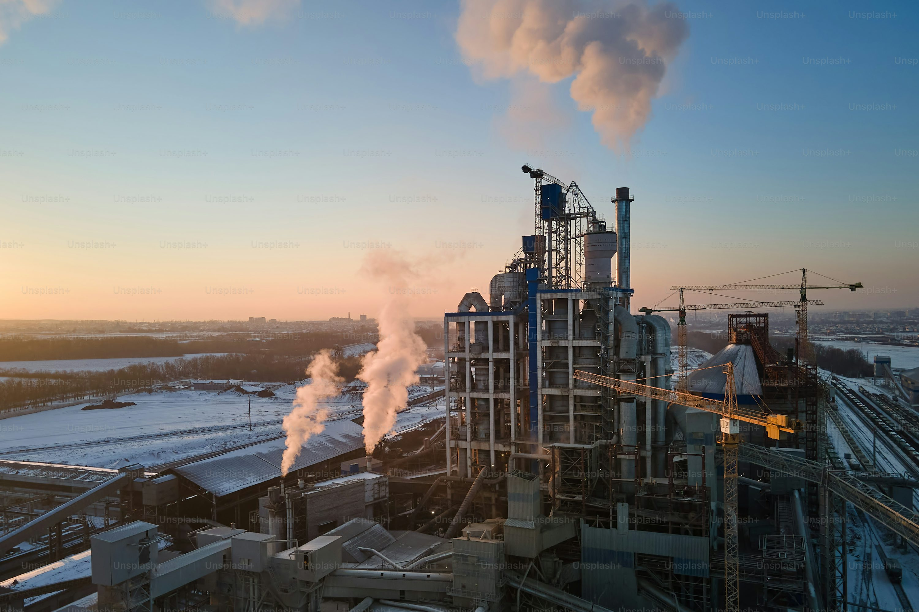
Industrial Process
Cement Production, CO₂
Steel manufacturing, CO2,CH4,N2O
Chemical production, CO2, N2O
Oil refineries, CO2, N2O
Aluminum Production CO2, PFCs
Pulp and Paper manufacturing CO2, CH4
Food and Beverages; CO2,CH4,N2O
Textile Manufacturing; CO2,CH4,N2O
Mining and Quarrying CO2, CH4
Industrial Emissions
Other
Land Clearance
Waste Generated
Energy Use
Use of Fossil fuel, Coal ,Biomass
Electricity etc.
Implemented by:

Slide 7
NDC 3.0 - Key Enhancements Over NDC 2.0
Implemented by:
Stronger Ambition & Broader Scope:
NDC 3.0 raises emission reduction targets and extends impact to 2035.
Improved Methodology:
Follows IPCC guidelines to ensure traceability and consistency.
Simplified Structure:
Consolidates 37 sub-PAMs into 7 key actions, focused on:
  Energy efficiency & management
  Renewable energy expansion
  Sustainable fuel switching
  Circular economy & RECP
  IPPU reduction in cement & lime
  HFC phase-down (new)
  Gender and youth inclusion (cross-cutting)

Slide 8
NDC 3.0 Targets for the Industry Sector
Increased Ambition and Impact
Implemented by:
13% GHG Emissions Reduction Target for the industry sector from 2026 to 2035
Target split:
  7% Unconditional
  (national efforts and finance)
  6% Conditional
  (depends on international finance, technology & capacity building)
Comparison with NDC 2.0 (2021–2030):
  Target: 7% total reduction
  Breakdown: 4% (unconditional) + 3% (conditional)
  Total reduction: 3,570 Gg CO₂e
NDC 3.0 shows a significant increase in ambition,
more than doubling projected reductions

Slide 9
Benefits for Industries
Implemented by:
Cost Saving
Energy efficiency
Resource Management
Investment Attraction
Access to funding
Government incentives
Enhance competitiveness
Innovation and efficiency
Access to new markets
Improved Reputation and Brand value
Enhanced corporate image
Stakeholder engagement
Risk Mitigation
Resilience to climate impacts
Regulatory Preparedness
Contribution to SDGs
Workforce Engagement and Retention
Attracting talent
Employee Engagement
Collaboration Opportunities

Slide 10
Thank you
Implemented by:

