Slide 1









Success Story:
Energy Management Systems @ Eco Spindles
Implemented by:
Colombo, 29 August 2025
Tharindu Bokanda
DGM – Yarn Operations
Eco Spindles Pvt Ltd
Dhanoj Prabhasara Jayarathne
Head of Engineering
Eco Spindle Pvt Ltd

Slide 2


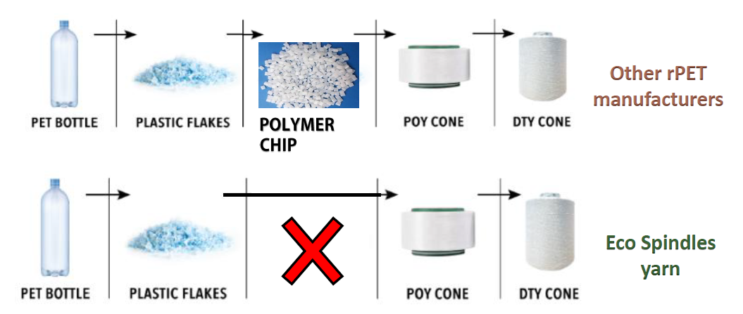





Eco Spindles Pvt Ltd …
Implemented by:
B P P L Holdings PLC
Description of the business
Largest PET recycler in Sri Lanka.
Eco Spindles is the largest and only recycled yarn spinner and the largest monofilament manufacturer in Sri Lanka, providing high graded filament yarn to the apparel and textile manufacturing & monofilaments
We own an advanced technology which converts PET flakes directly to yarn and monofilaments to create a second life for plastic waste
Our Technology
The specialty of ECOS recycled yarn is that we produce with lowest carbon footprint, due to the unique direct “FLAKE to POY” technology, which circumvents polymerization process.
Energy Impact to cost of production – 20 %

Slide 3
Energy management initiatives at Eco Spindles
Implemented by:
  Objectives of the EnMS
  Improve Energy Efficiency
  Continuously improve processes to achieve a minimum of 4% increase in energy efficiency per year, measured against the established baseline (2023), through implementation of energy-saving projects and operational controls.
  Establish Energy Conservation Culture
  Foster a strong energy conservation culture across the organization by fully implementing ISO 50001:2018 Energy Management System (EnMS) and obtaining certification by Q4 2025.
  Inputs and resources
  Funding sources
  Organizations own fund (Reliable convincing tools)
  Specific EnMS activities
  Energy Planning, Implementation & Operation, Monitoring & Measurements, Performance evaluation, Continuous Improvements.
Technical know-how (Analytical Tools) | Audit experiences
Devices and Instruments | Opportunity to identify ESOs through industrial energy experts

Slide 4
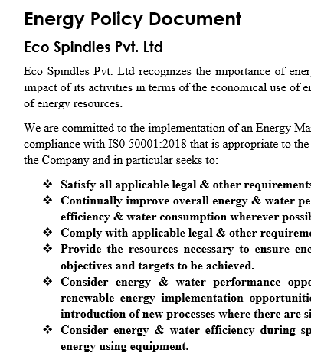
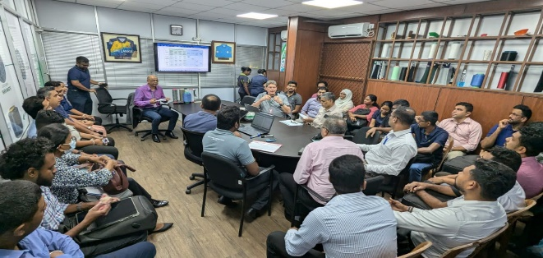
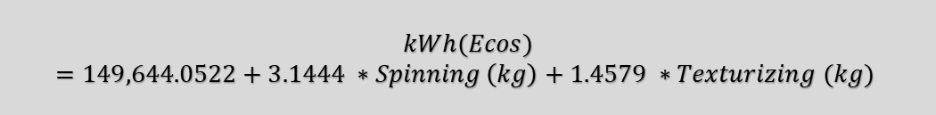
Energy management initiatives at Eco Spindles
Implemented by:
$$kWh(Ecos)=149,644.0522+3.1444 ∗Spinning \left(kg\right)+1.4579 ∗Texturizing (kg)$$

Slide 5
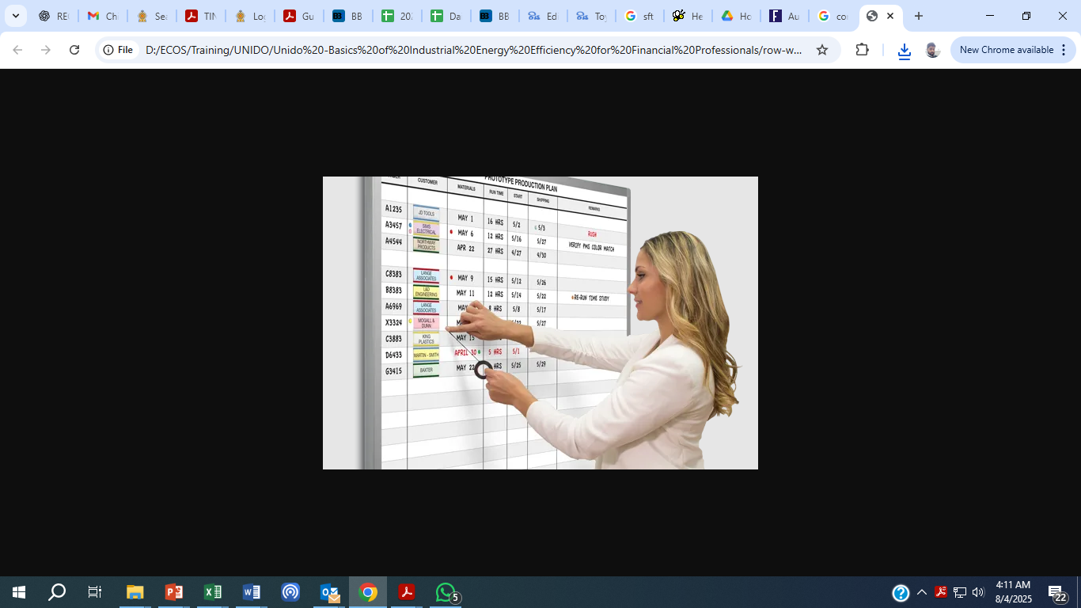
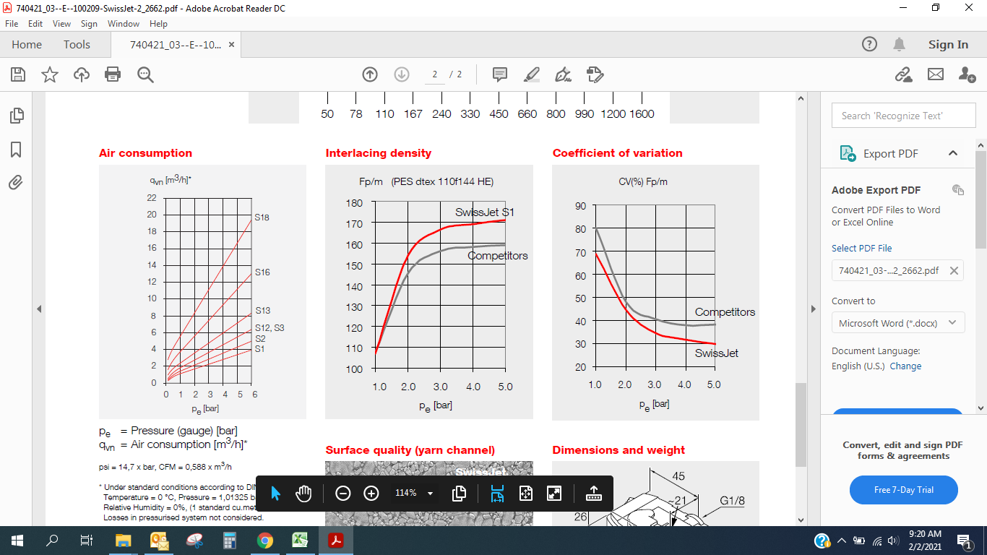

Energy management initiatives at Eco Spindles
Implemented by:
Savings with No Investment (p.a.) | kWh
Start-up time reduction | 68,760
Keep continuous operation | 162,504
Max utilization of Pyrolysis oven | 10,944
Keep close non using air jets | 6,276
Decrease pressure set values | 382,644
Compressor running plan according to Calculated demand | 76,524

Slide 6
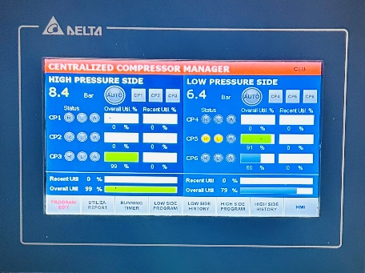
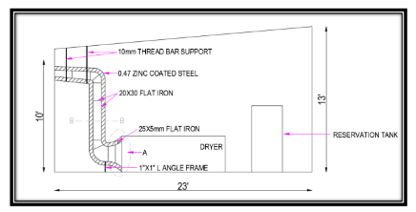
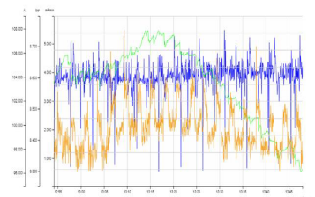
Energy management initiatives at Eco Spindles
Implemented by:
Savings with Investments (p.a.)
Description | Investment (LKR) | Electrical Saving /Annual (kWh) | ROI (Years)
Chiller utilization for UPS room Ventilation | 1,467,527 | 44,412 | 1.12
Separate pressure connections (High & Low) | 2,201,936 | 58,776 | 1.27
Compressor manager device for control compressors | 1,693,224 | 57,396 | 1.0
Float valve instead of time auto drains | 1,908,006 | 59,340 | 1.09
Ventilation Compressor room | 3,007,640 | 53,940 | 1.89
Convert another fix compressor in to VFD | 2,505,972 | 76,524 | 1.11
Compressed air renting to Recycling from Yarn plant | 2,839,000 | 56,976 | 1.39
High efficient compressor buy back plan | 19,349,200 | 305,076 | 2.15

Slide 7
Intended and un-intended results of EnMS activities
Implemented by:
Intended
Achieving SBTi requested by the brands
Improved Energy Performance
Cost Savings
Environmental Benefits
Process Optimization
Reputation & Market Advantage
Employee Engagement & Team building
Un-Intended
Reduce Operational Risks
Improvement in operational Safety
Reduce equipment Stress

Slide 8
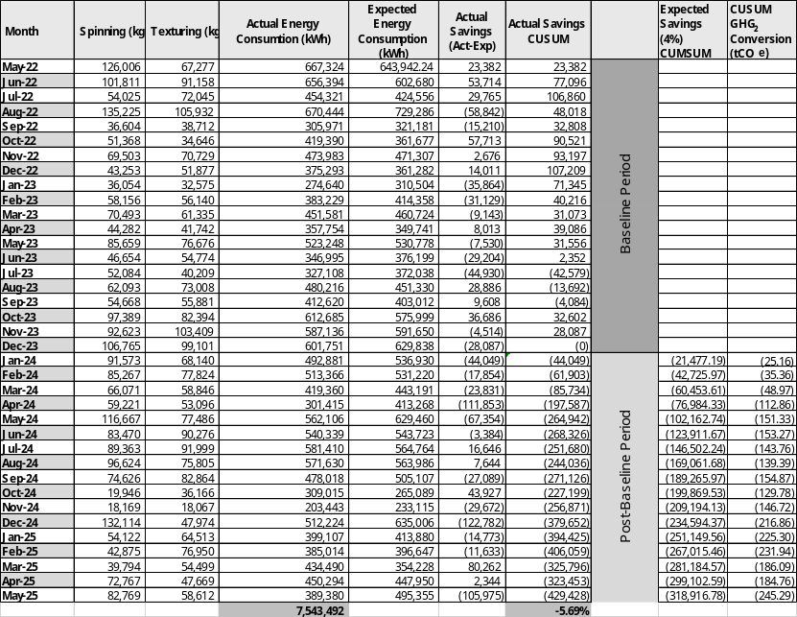
Intended and un-intended results of EnMS activities
Implemented by:
Total Energy Saving (Eco Spindles) -18 Months
Total Units Saved (5.69%) | 429,428 | kWh
Total Cost Saved | 7,543,492 | LKR

Slide 9
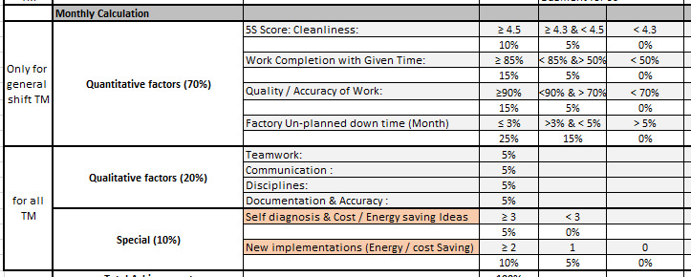
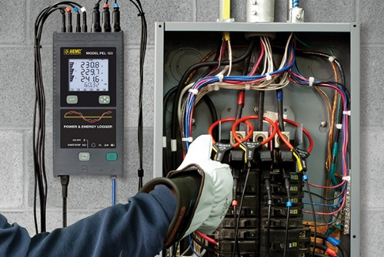
Challenges, risks and mitigation action
Implemented by:
Financial challenges
Technical challenges
- Devices and equipment
- Technical know-how
Reluctant to change
Procurement challenges

Slide 10
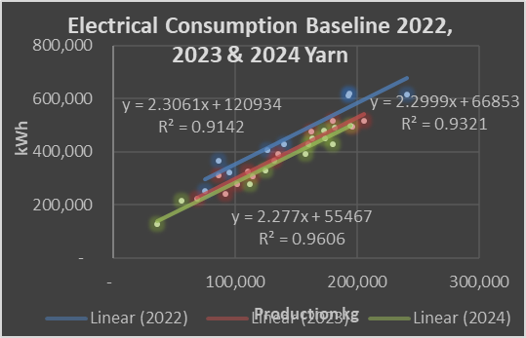
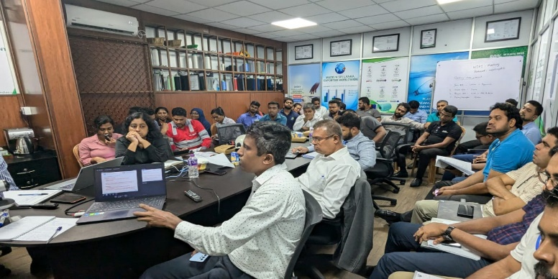
Sustainability of EnMS efforts, and way forward
Implemented by:
  Formation of energy Team and team meetings
  Continuous training and competency improvements
  Maintaining ESO List & updating it continuously
  Continuous data monitoring (Baseline Improvements)
  Rewards for achievements – Incentives & KPI evaluations
  Established ground rules for procurements
  Internal & external Audits

Slide 11
Thank You …
Implemented by:

