Slide 1









Success Story:
Energy Management Systems @
Talawakelle Tea Estates PLC
Implemented by:
Colombo, 29 August 2025
Shehara Jayakodi
Executive – Sustainability & Corporate Reporting
Pubudu Bandara
Executive-Sustainability & Quality Systems Development

Slide 2










Implemented by:
16
450T Per Annum
HOLYROOD FACTORY
16.5TJ Per Annum
Management commitment and supportive team

Slide 3
Before the intervention:
Energy management challenges
Implemented by:
Manufacturing is energy intensive – withering, rolling, drying, sorting.
Heavy use of biomass (firewood) and electricity → high cost & emissions.
Needs & Challenges (Before Initiative)
Rising energy costs & Proper monitoring.
No systematic EnMS / limited monitoring of energy performance.
Inefficient boiler & dryer operations → excessive fuel use.
Lack of technical know-how & baseline data for emission reduction.
Maintenance gaps leading to avoidable energy losses.
Limited awareness on renewable/alternative energy solutions.

Slide 4
Before the intervention:
Energy management challenges
Implemented by:

Slide 5
The actions based on AICRSL project support:
Energy management initiatives
Implemented by:
Objectives of EnMS Activities
Reduce energy consumption Base on 2023 year consumption.
Minimize GHG emissions and reliance on firewood.
Improve efficiency of boilers, dryers, and electrical systems.
Establish systematic monitoring & reporting (ISO 50001).
Build awareness and capacity among factory and estate teams.

Slide 6
The actions based on AICRSL project support:
Energy management initiatives/projects
Implemented by:
VFD Installation
            Installed Variable Frequency Drive (VFD) for withering fan to optimize energy efficiency.
Firewood Optimization
  Using firewood off-cuts instead of normal firewood.
  Implementing firewood moisture monitoring and control measures.
Boiler Maintenance
  Completed boiler repair work to improve reliability and performance.

Slide 7
The actions based on AICRSL project support:
Energy management initiatives
Implemented by:
Leadership & Guidance – Energy Manager (Mr. Krishna Chathuranga) & Sustainability Team.
Capacity building & training for managers and staff.
Mentorship was provided throughout the EnMS, covering project implementation, internal audits, and external audits.
Identification of process optimization & emission reduction opportunities.
Ground Support
Factory staff, estate management, supervisors.
Expertise
EnMS Training and tools from AICRSL/UNIDO. EnMS project team.
Funding Sources
Company operational budget allocations.
AICRSL project support (capacity building & technical inputs).

Slide 8
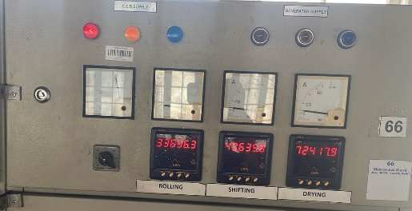
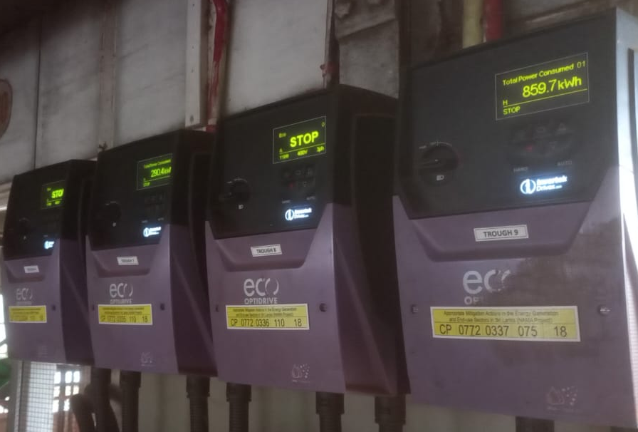
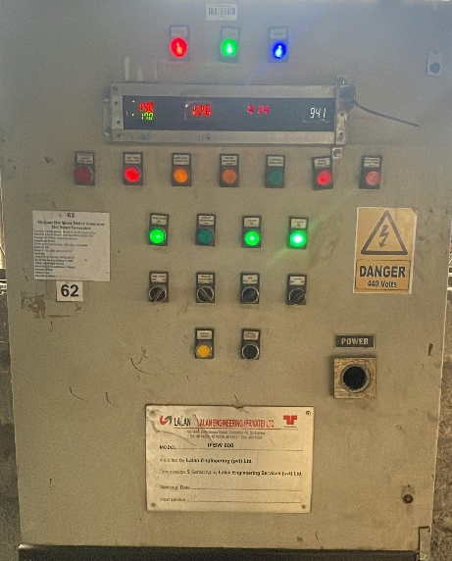
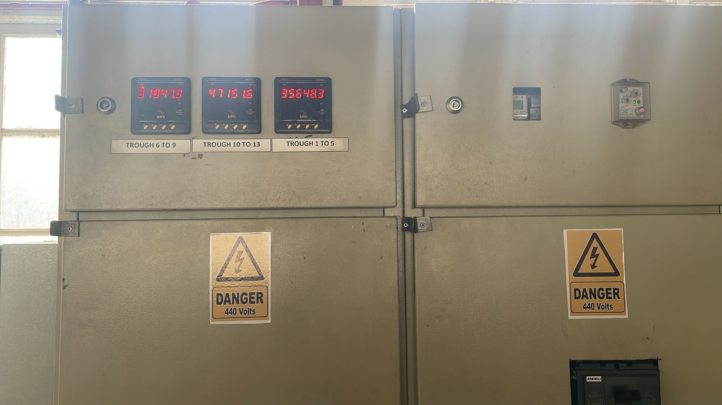
The actions based on AICRSL project support:
Energy management initiatives
Implemented by:

Slide 9
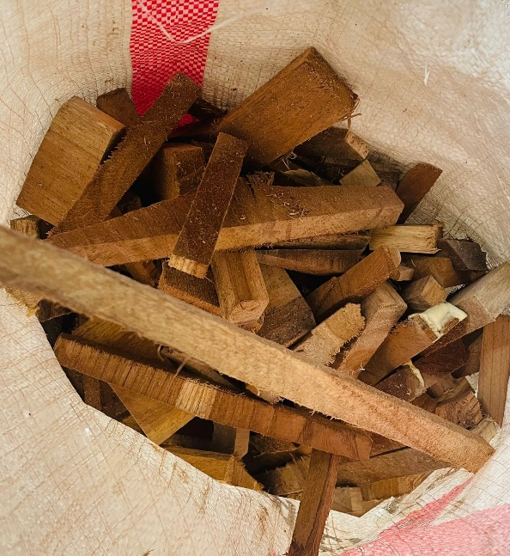
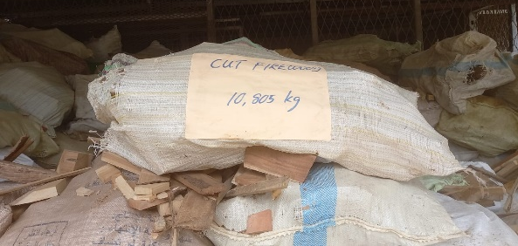
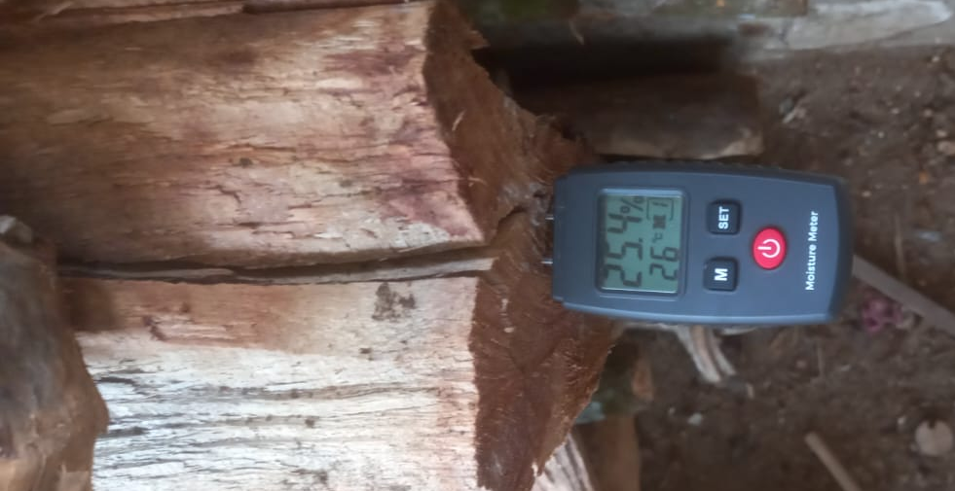
The actions based on AICRSL project support:
Energy management initiatives
Implemented by:

Slide 10
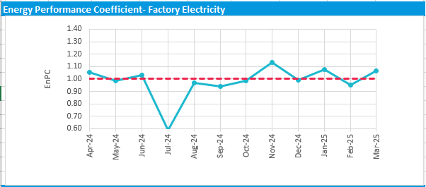
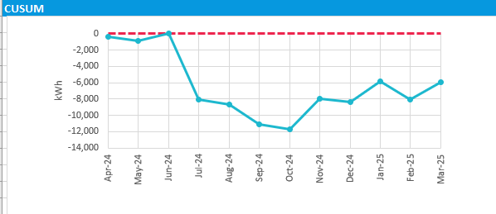
Benefits and impact:
Intended and un-intended results of EnMS activities
Implemented by:

Slide 11
Course corrections:
Challenges, risks and mitigation action
Implemented by:
Challenges and risks | Mitigation action
Technical: Manual monitoring and analyzing. Efficiency monitoring and verification | Sub-meters have been installed, and consumption is analyzed monthly. High-capacity motors have been verified, and a plan is in place to monitor the efficiency of mechanical systems.
Investments: Difficulty in securing funds for renewable energy/modern tech. | Solar heating and mini-hydro projects are in progress with funding support from AICRSL.
Capacity building: Need for awareness and behavior change at factory/estate level. | Focused training sessions on operating VFDs and boilers to improve efficiency, safety, and performance.

Slide 12
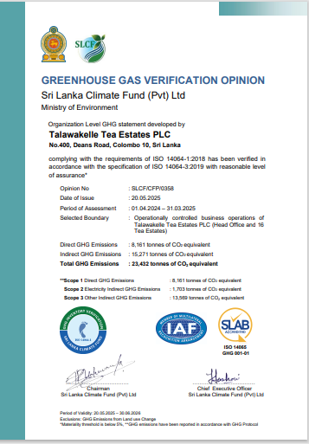
Future outlook:
Sustainability of EnMS efforts, and way forward
Implemented by:
Continuous Monitoring
  Frequent monitoring until it becomes part of daily routine operations.
Capacity Building
  Regular trainings and awareness programs to improve staff knowledge and skills.
System Efficiency
  Planned verification of mechanical system efficiency to ensure optimal performance.
ISO 50001 Expansion
  Holyrood factory certified ISO 50001, Ongoing implementation in remaining factories. Basic practices already applied; full implementation in progress.
GHG Emission Management
  Continuous monitoring and verification of greenhouse gas emissions to support sustainability goals.

Slide 13


