Slide 1









Success Story:
Energy Management System @ Flintec Transducers Pvt Ltd
Implemented by:
Colombo, 29 August 2025
Asanka Manoj
General Manager – Operations
Flintec Transducers Pvt Ltd

Slide 2


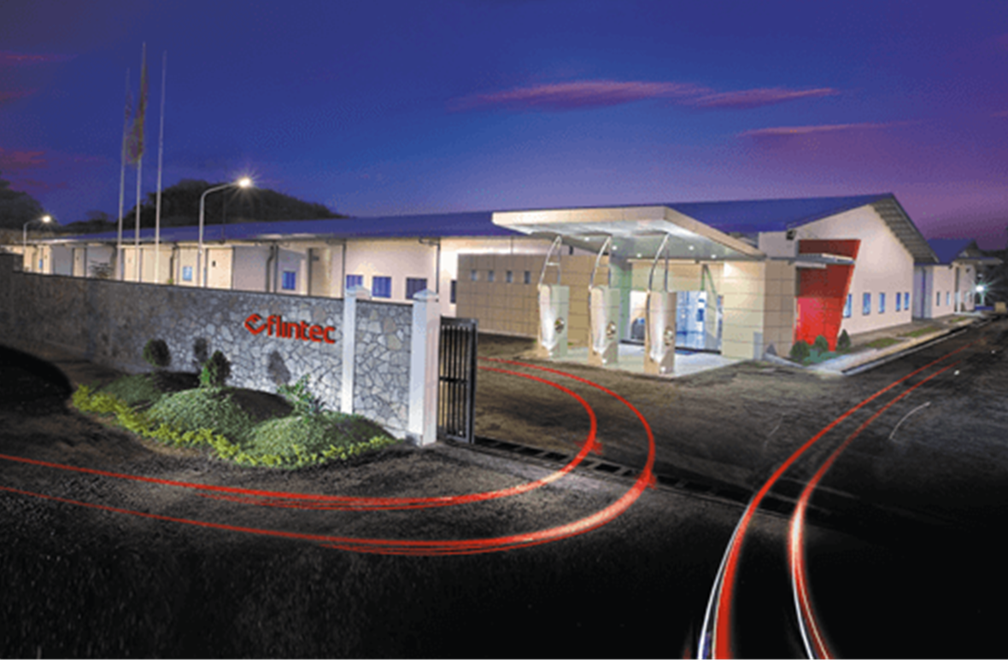
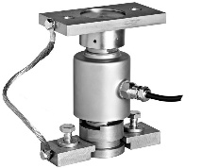
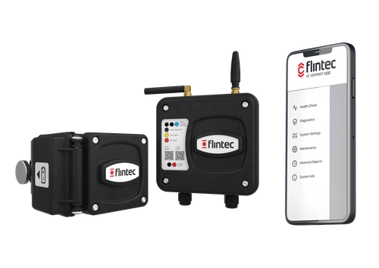
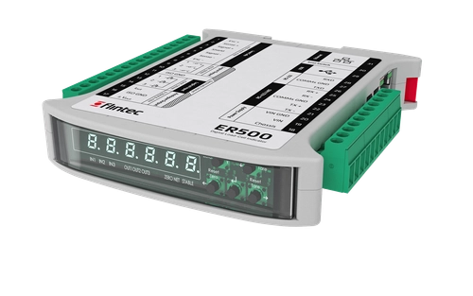


Before the intervention:
Energy management challenges
Implemented by:
Flintec is a world leading manufacturer of precision weight measurement technologies.
Energy-Intensive Manufacturing (2022 Data)
82% of total energy = Electricity (5,100,000 kWh/year)
Machine shop 60 CNC machines → 54,000 kWh/month
Heat treatment Vacuum & Atmospheric furnaces → 62,000 kWh/month
AC System → 175,000 kWh/month
Compressed Air System → 80,000 kWh/month
Challenges
Sustainability targets from the INDUTRADE group
2022-2023 Energy/ Fuel crisis
Limited Energy Management awareness
No system to track energy savings

Slide 3
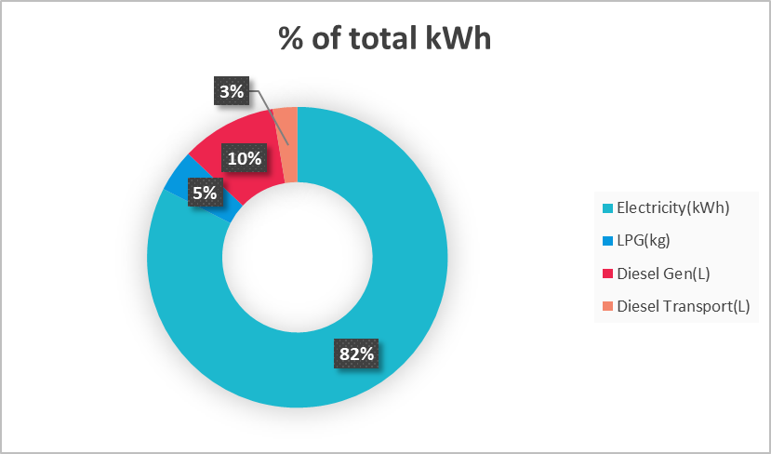
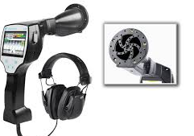

The actions based on AICRSL project support:
Energy management initiatives at Flintec
Implemented by:
Objectives
Reduce electrical energy use by 10% by 2026 (baseline 2022/23)
Promote sustainability via clean energy, efficiency, and compliance.
EnMS Activities
By analyzing the energy balance identifying 82% energy is from Electricity.
SEU Idetification(AC, Compressed Air, Heat treatment)
Use baselines & EnPIs to track the progress
Regression analysis for each SEU to identify EnPIs
Inputs & Resources
Self-assessment & compliance review
Stakeholder requirements
Energy Teams & Roles
Energy data (Electricity, LPG, Diesel, Water, Gases)
Funding Sources
1st year only no/low cost initiatives
Investment in energy saving projects (ex., Compressed air Leak detector)
Capacity building programs
Project investment: $9981
Annual saving : $7363
ROI (Months) : 15 months

Slide 4
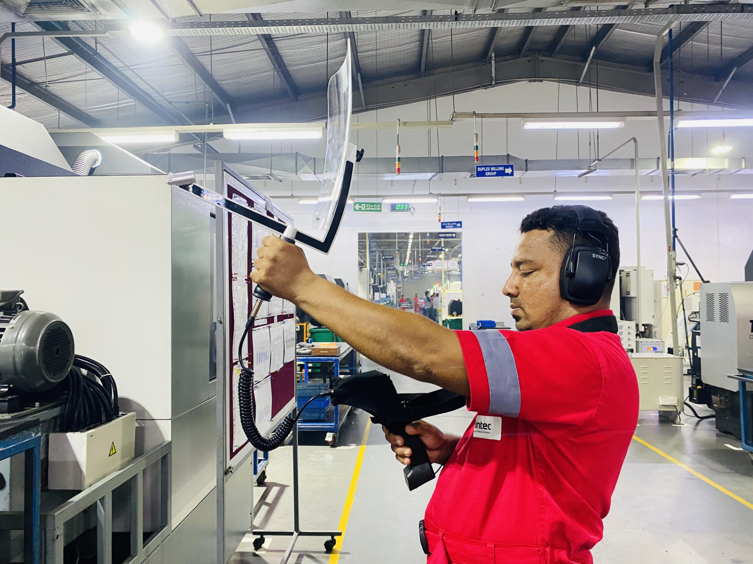
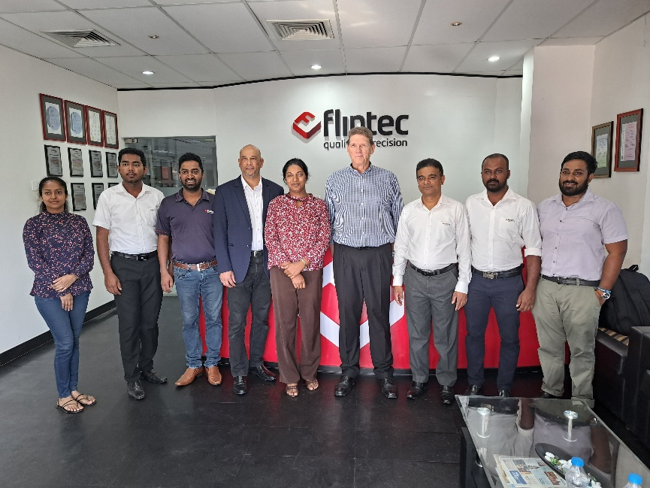

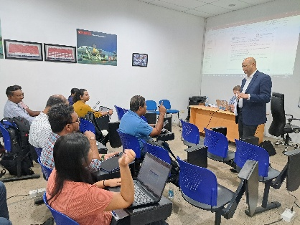
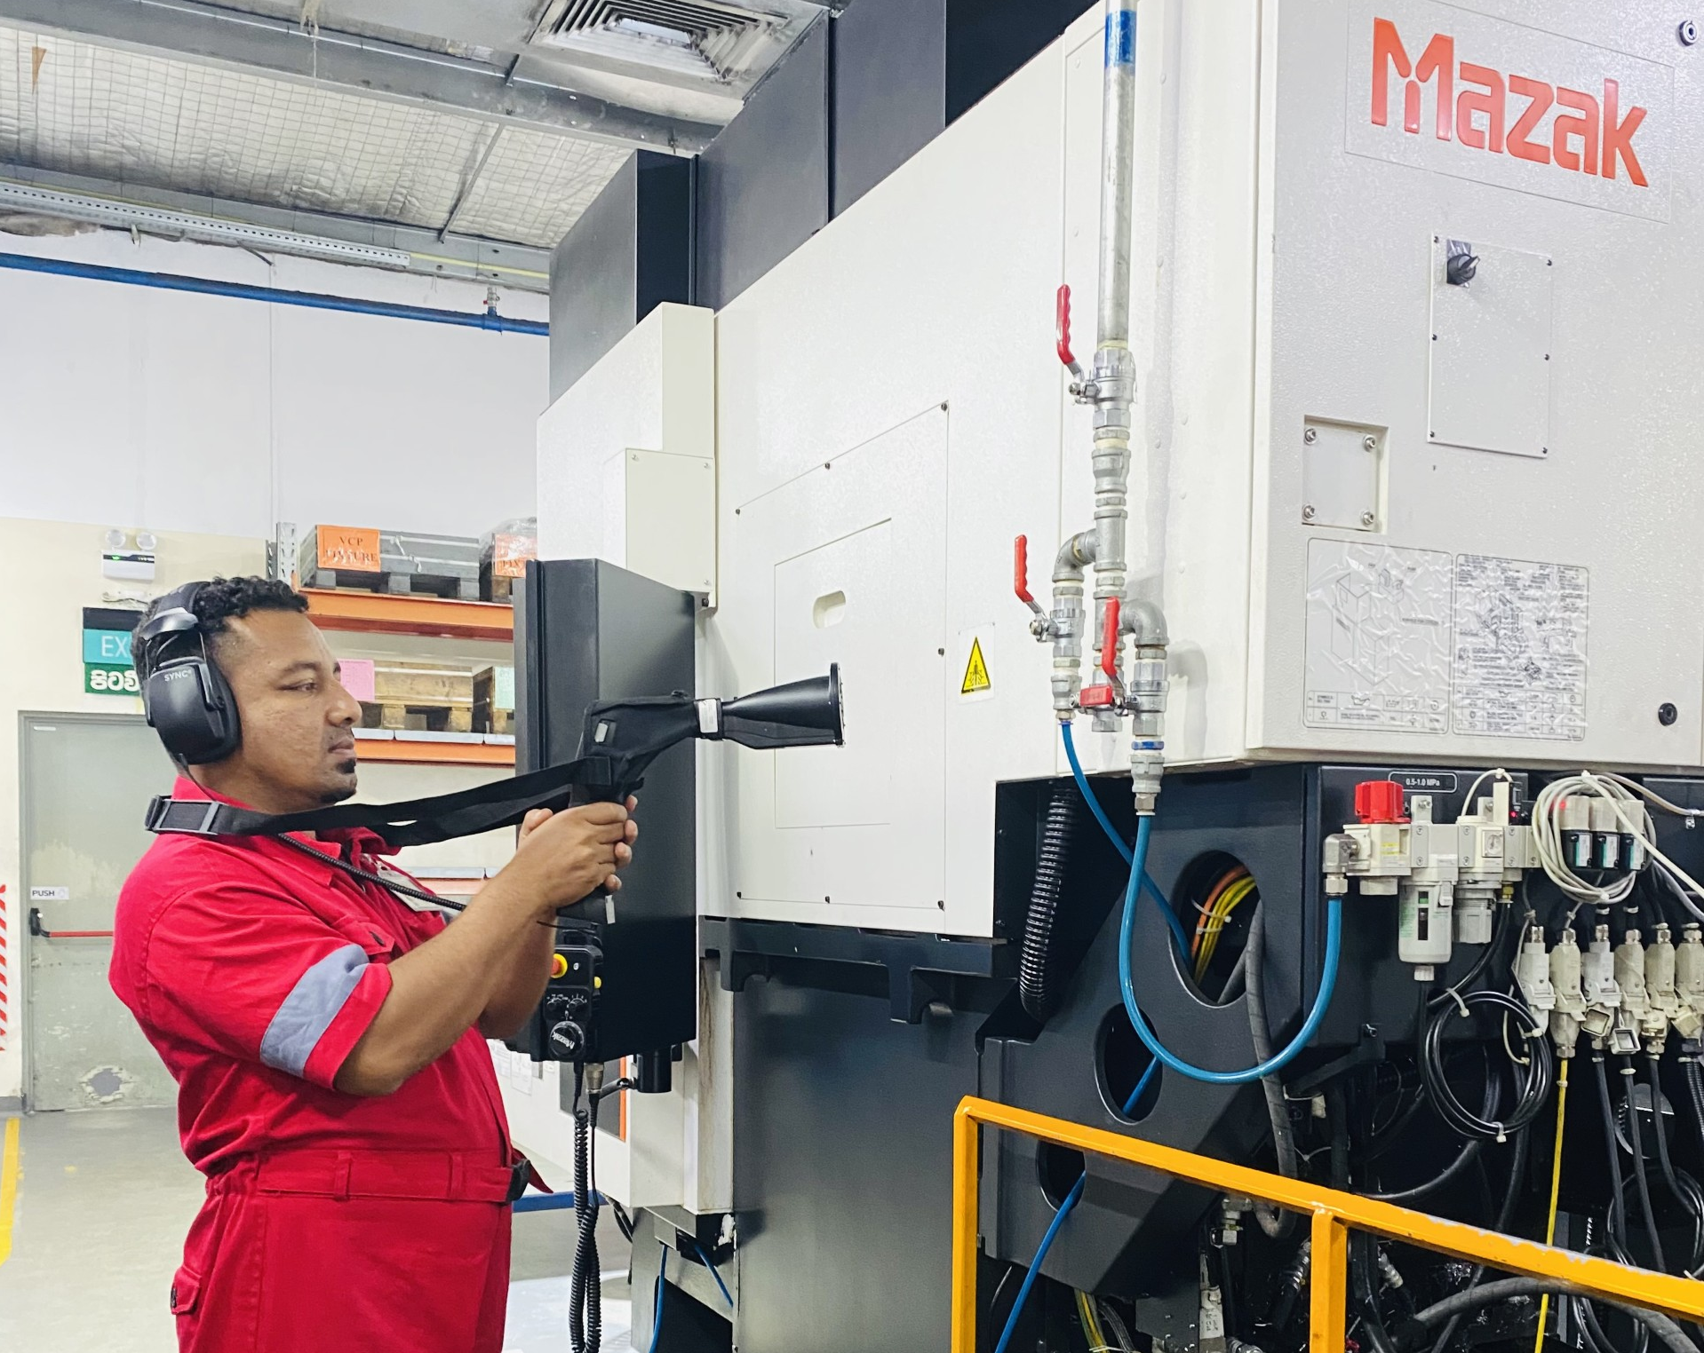
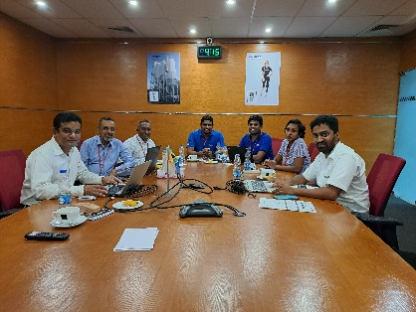
The actions based on AICRSL project support:
Energy management initiatives at Flintec
Implemented by:

Slide 5
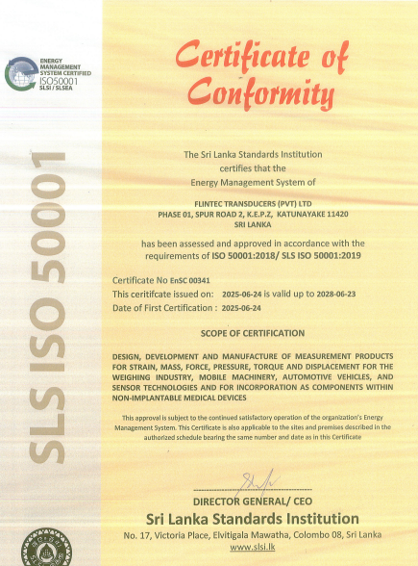
Benefits and impact:
Intended and un-intended results of EnMS activities
Implemented by:
🏅 ISO 50001 Certification
46,723 USD
Total Saving
🌱 Sustainability & Emission Reduction
Carbon savings: 363 tCO₂e
📈 Energy & Cost Savings
Zero-investment savings: 290,000+ kWh
Ongoing Kaizen engagement
510,914 kWh
Energy Saving
💡 Business Value
Enhance company’s reputation
Demonstrates measurable value to stake holders
363 tCO2e
Emission Saving
Jan 2023 – July 2025

Slide 6
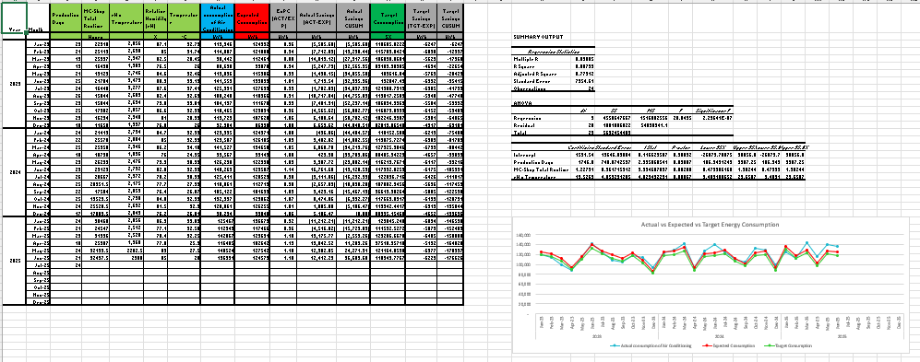
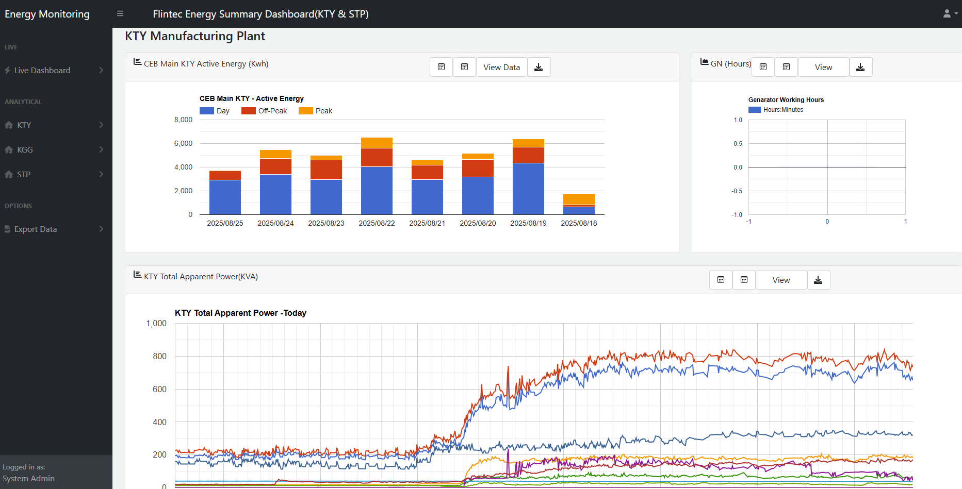
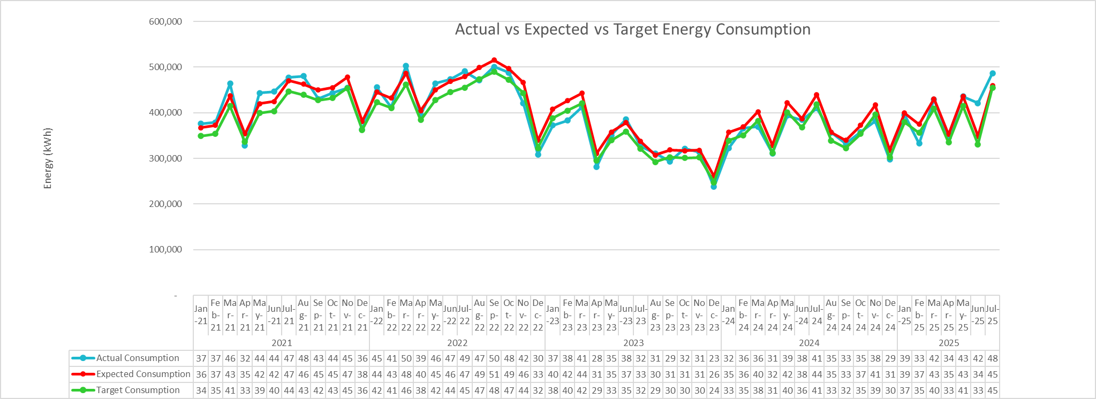
Benefits and impact:
Intended and un-intended results of EnMS activities
Implemented by:
Data driven decisions via dash boards
Energy Monitoring System Dashboard

Slide 7
Course corrections:
Challenges, risks and mitigation action
Implemented by:
Lack of energy management knowledge:
Mitigation action :-
Training programs for Energy Management Teams
Awareness via meetings & Kaizen rewards
In-plant trainee involvement to support EnMS
Difficulty in securing dedicated funds
Mitigation action :-
Focus on zero/low-cost initiatives first (e.g., AHU temperature control, compressed air leak corrections, AC switch off on nonworking days)
Savings used to justify investments
Gaining consistent senior leadership support
Mitigation action :-
Regular (monthly) progress reporting with measurable results (EnPIs, savings)
EnMS tied to business & sustainability goals

Slide 8
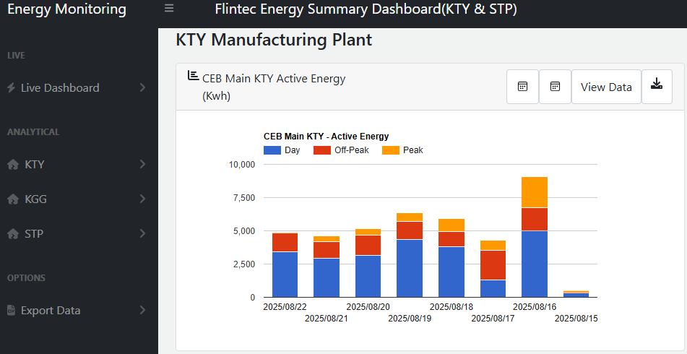

Future outlook:
Sustainability of EnMS efforts, and way forward
Implemented by:
Monitoring & Evaluation
Sustaining
Way Forward
Both KTY and KGG facilities aligned under the same goal & potential
Energy monitoring system tracks usage 24/7
Regular updates on energy, carbon & cost savings
Keeps leadership informed & motivated
Prioritization of SEU-related projects in annual budgeting
Ongoing staff training and awareness.
Strengthening internal capacity for lasting impact
People motivating from Kaizen rewards.
Ongoing and planned energy saving projects,
AHU Automation and air balancing
Compressed air monitoring system
Cooling tower optimization
10% Electrical energy saving by 2026

