Slide 1









Success Story:
Energy Management Systems @ Teejay
Implemented by:
Colombo, 29 August 2025
Mendaka Hettithanthri
Deputy General Manager – Teejay group

Slide 2


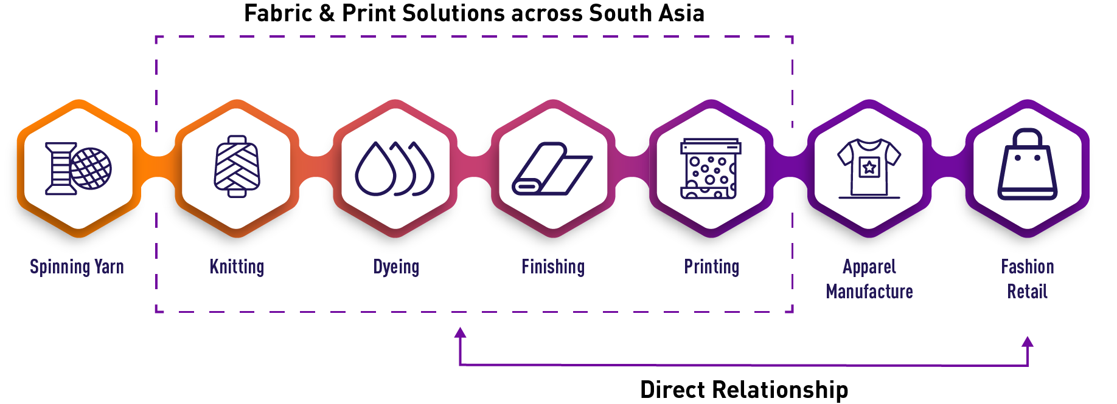
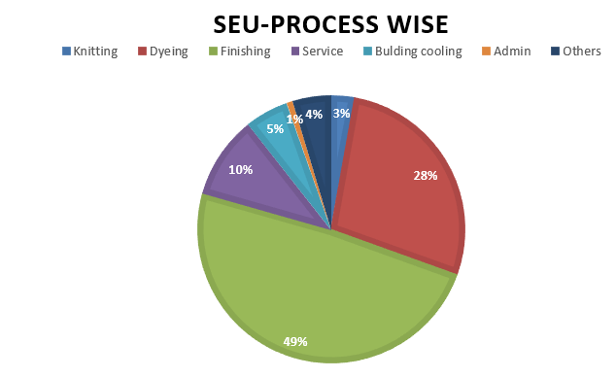
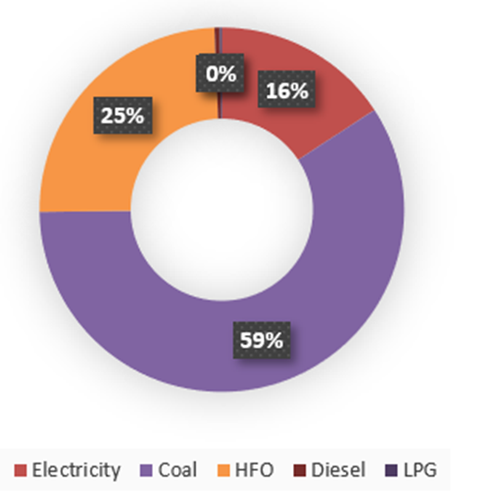


Company Overview and Energy-Intensive Nature of Manufacturing
Implemented by:
Teejay Lanka PLC – Sri Lanka’s first and only multinational knit fabric manufacturer (est. 2000), supplying knitted and printed fabrics to leading global brands such as Nike, PVH, Marks & Spencer, Victoria’s Secret, and Calzedonia.
ENERGY BALANCE

Slide 3

Before the intervention:
Energy management challenges
Implemented by:
Energy Rise Linked to Changes in Production Mix
High Scope 1, Scope 2, and Scope 3 emissions
Low awareness among operators
Lack of Management Involvement
No systematic approach for Energy Management
Absence of machine-level performance and utilization tracking

Slide 4

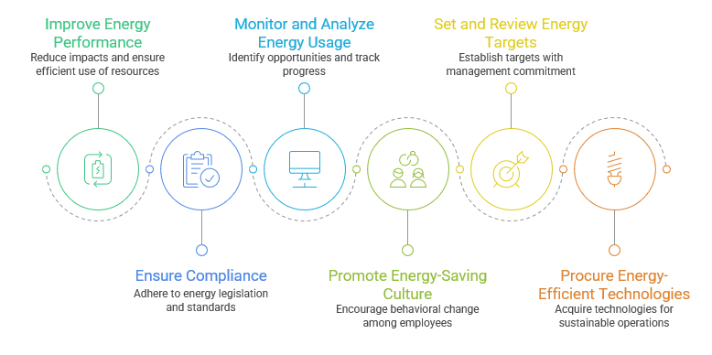
The actions based on AICRSL project support:
Energy management initiatives at Teejay Lanka PLC
Implemented by:
Implement ISO 50001 Energy Management System as a structured framework for systematic energy management.

Slide 5
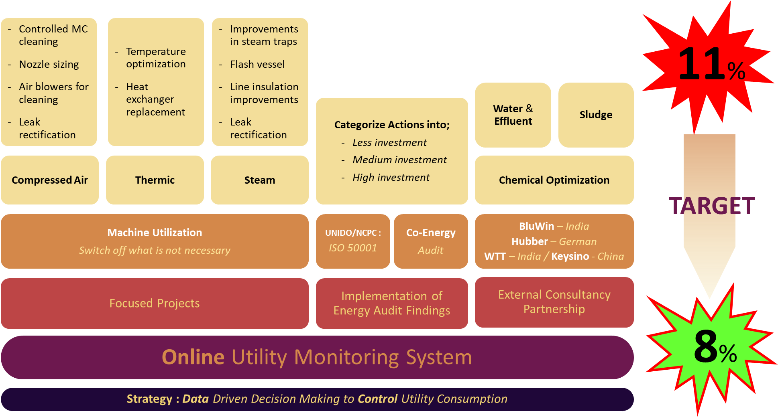
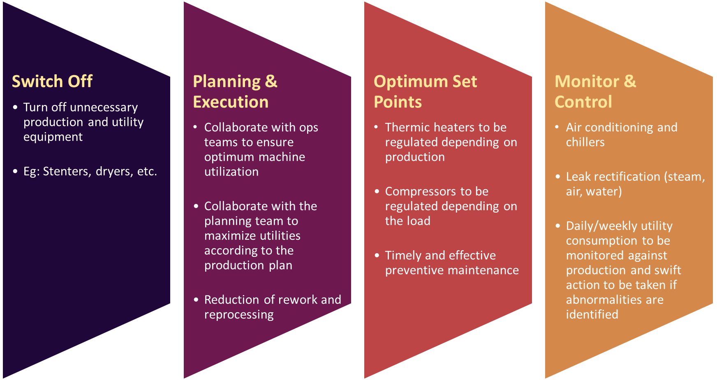
The actions based on AICRSL project support:
Energy management initiatives at Teejay Lanka PLC
Implemented by:
Developed energy management frame-work and set target
Developed energy management strategy for machines and utility

Slide 6
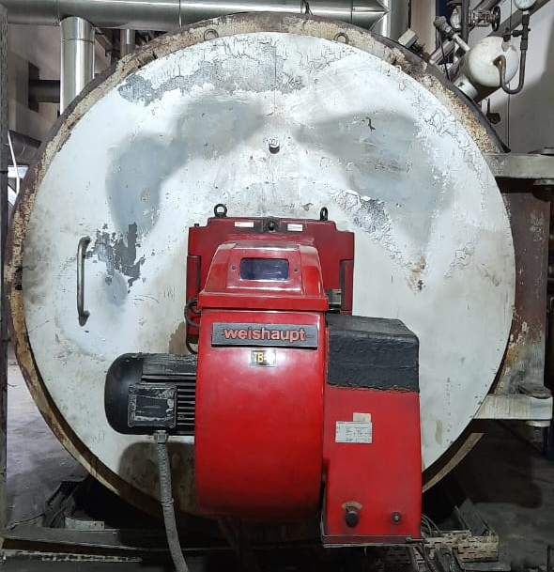
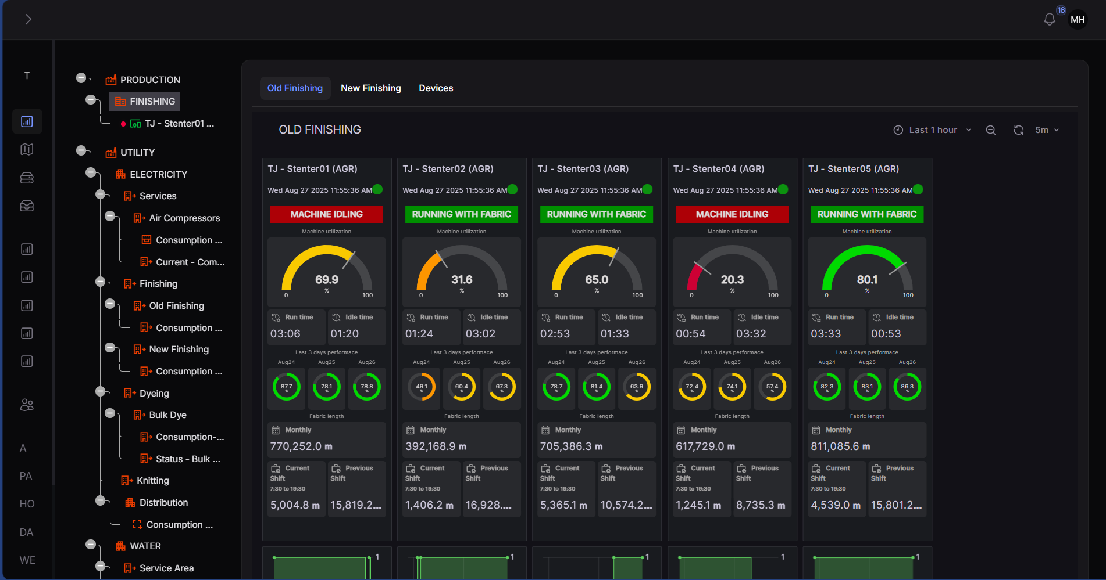
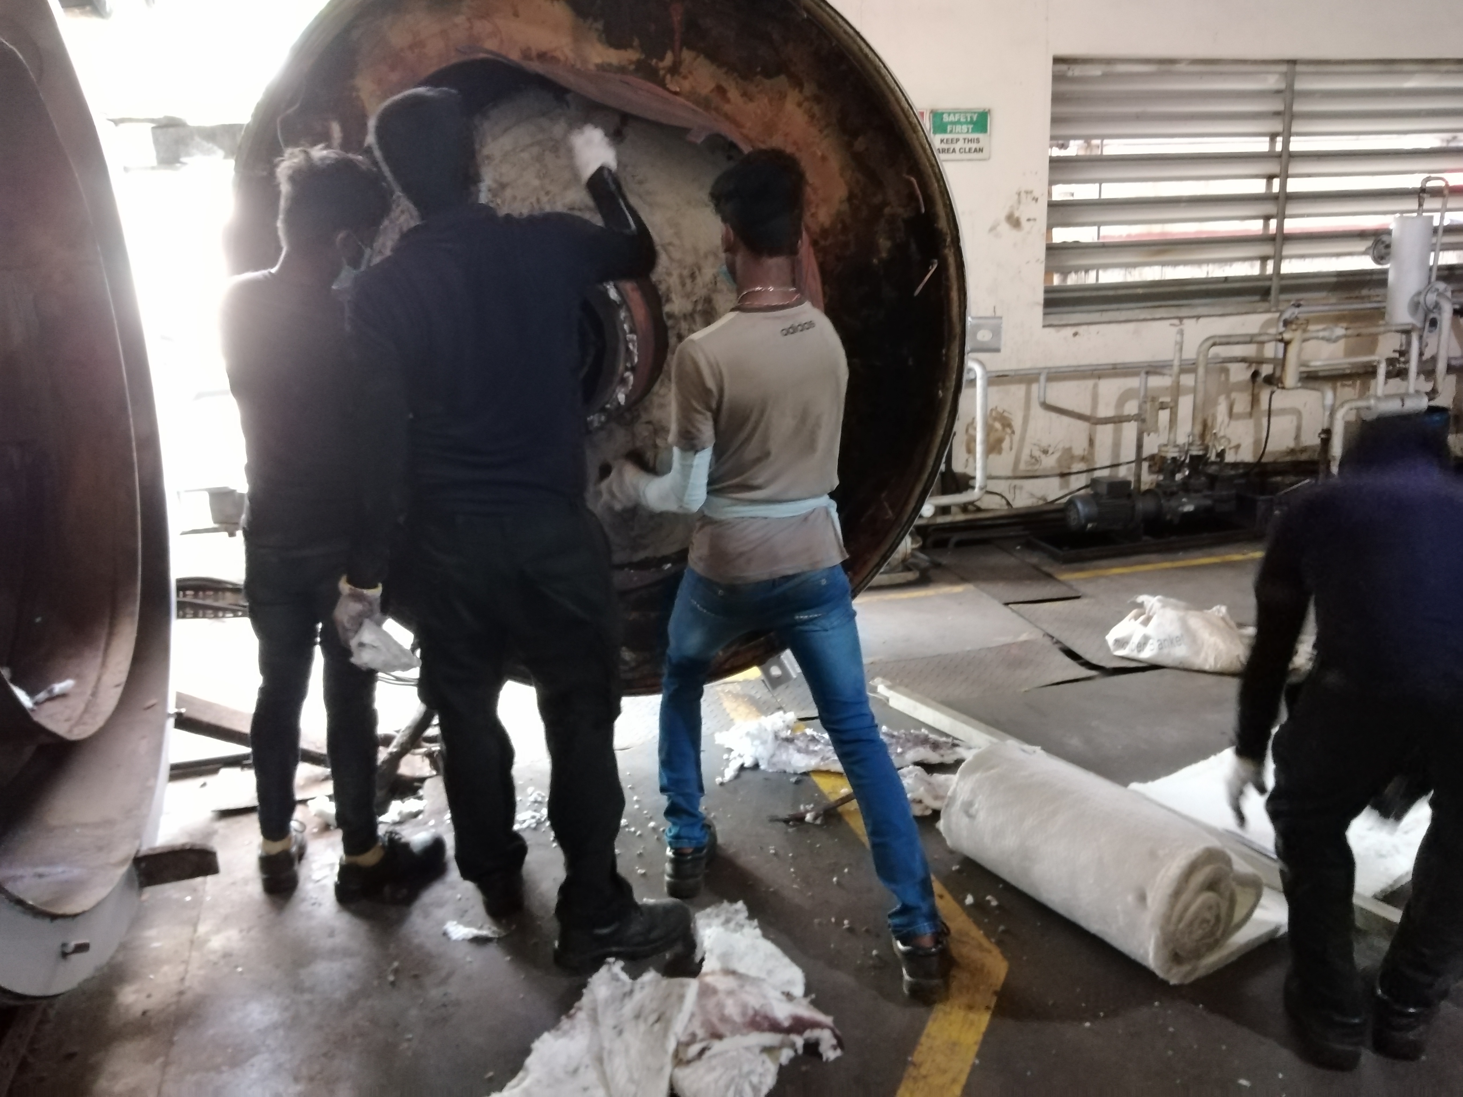
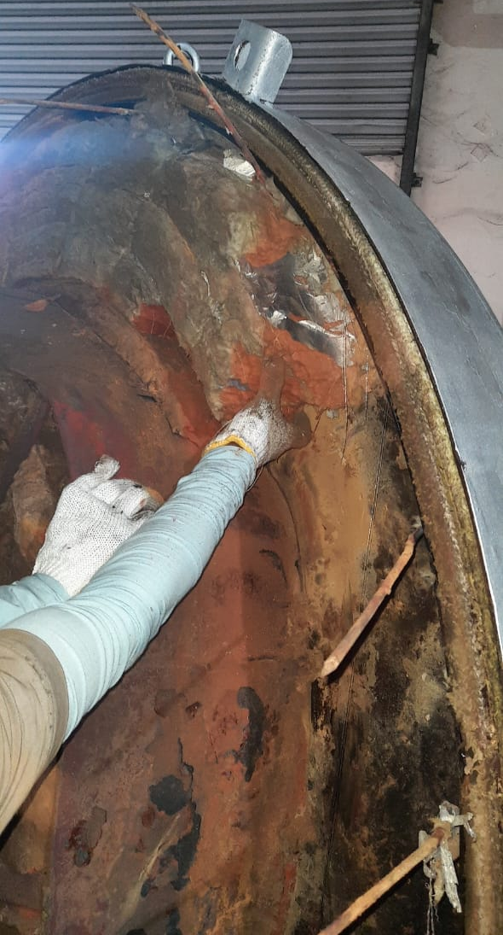
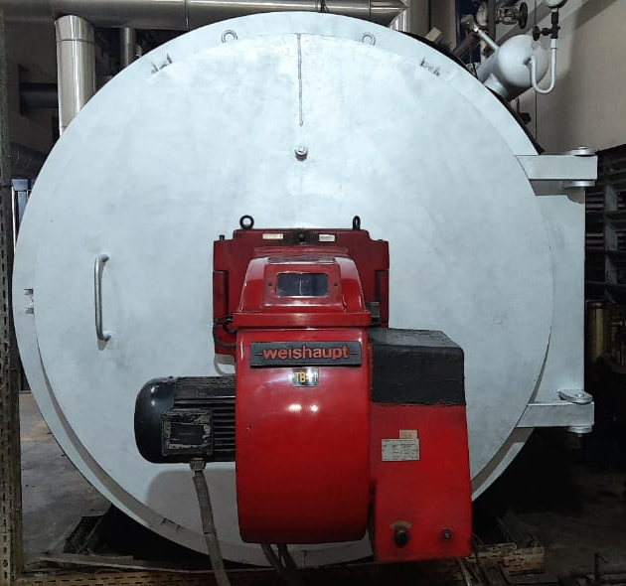
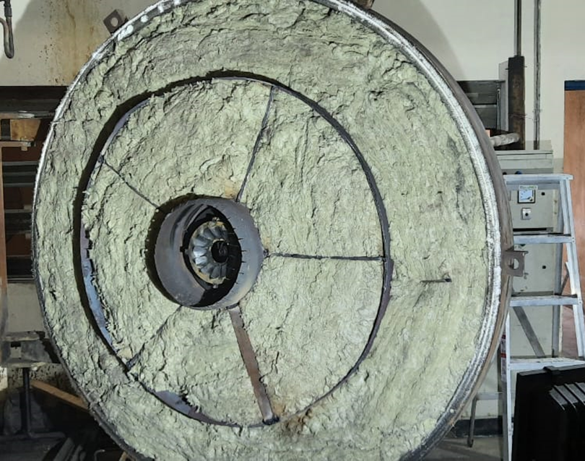
The actions based on AICRSL project support:
Energy management initiatives at Teejay Lanka PLC
Implemented by:
IoT system for Utility management,
Machine Utilization and Improve productivity
Inhouse full refurbishment of thermic heaters and optimizing set points (previous set point was 265 degrees, now set at 250 degrees)

Slide 7
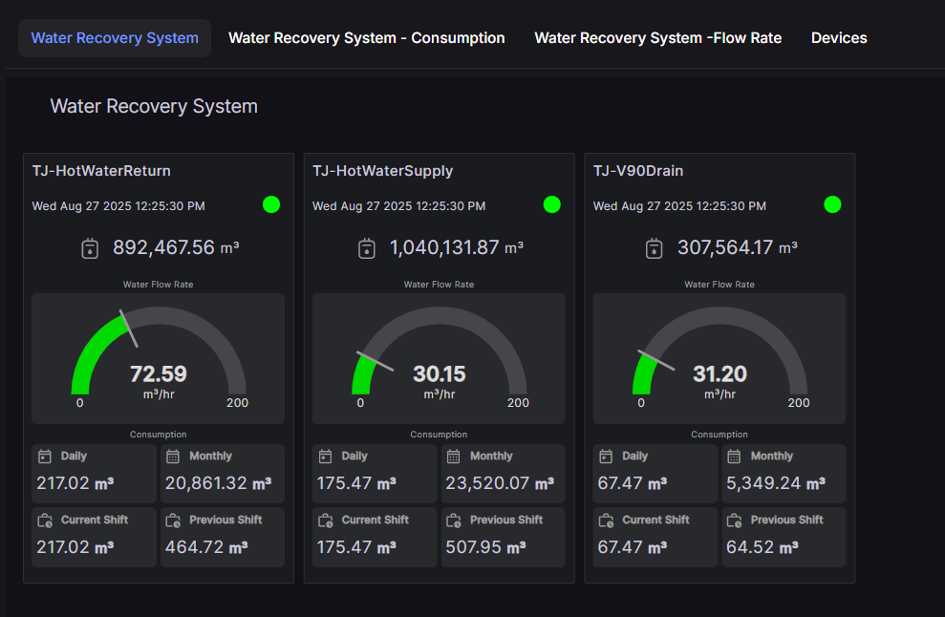
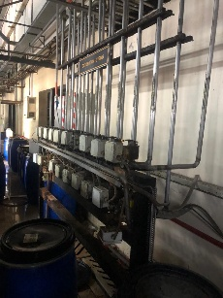
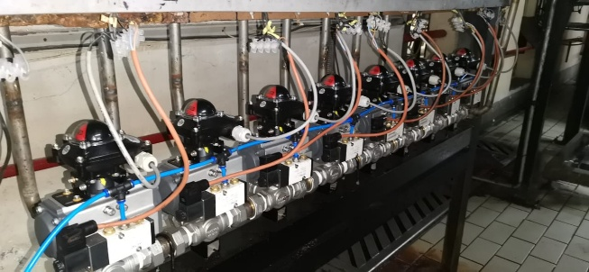
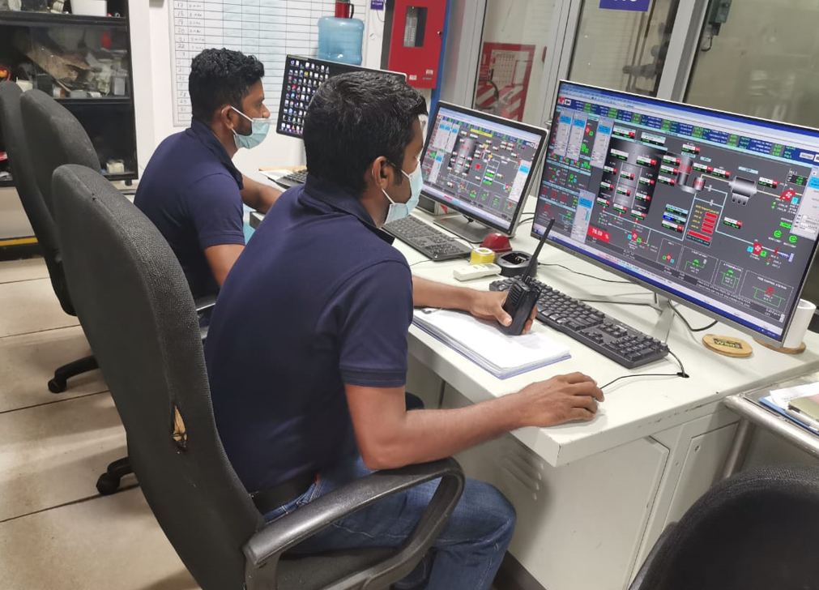
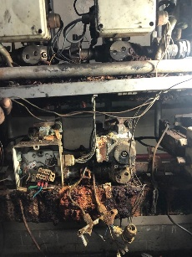
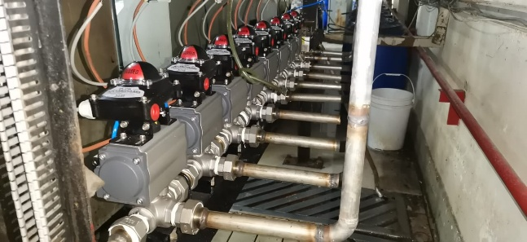
The actions based on AICRSL project support:
Energy management initiatives at Teejay Lanka PLC
Implemented by:
Reduce steam demand (Trap replacement and leak rectification) and improve condensate and flash steam recovery
Improve hot water recovery from the dyeing process and reuse
Refurbished all pneumatic actuators to stop air leakages and to better manage the air supply

Slide 8
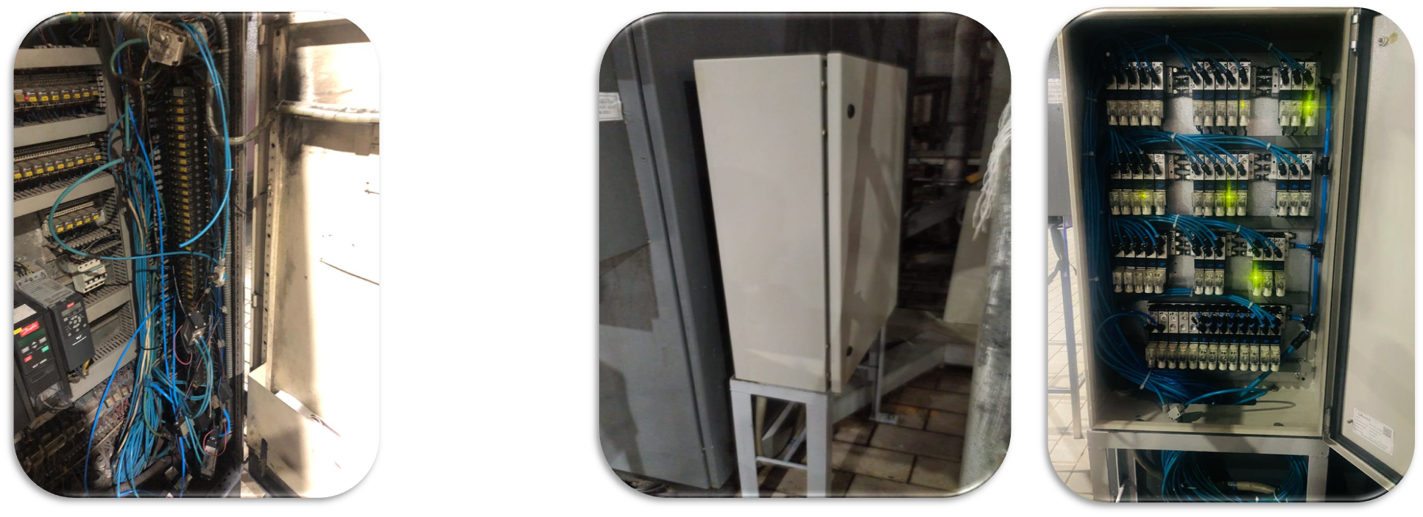
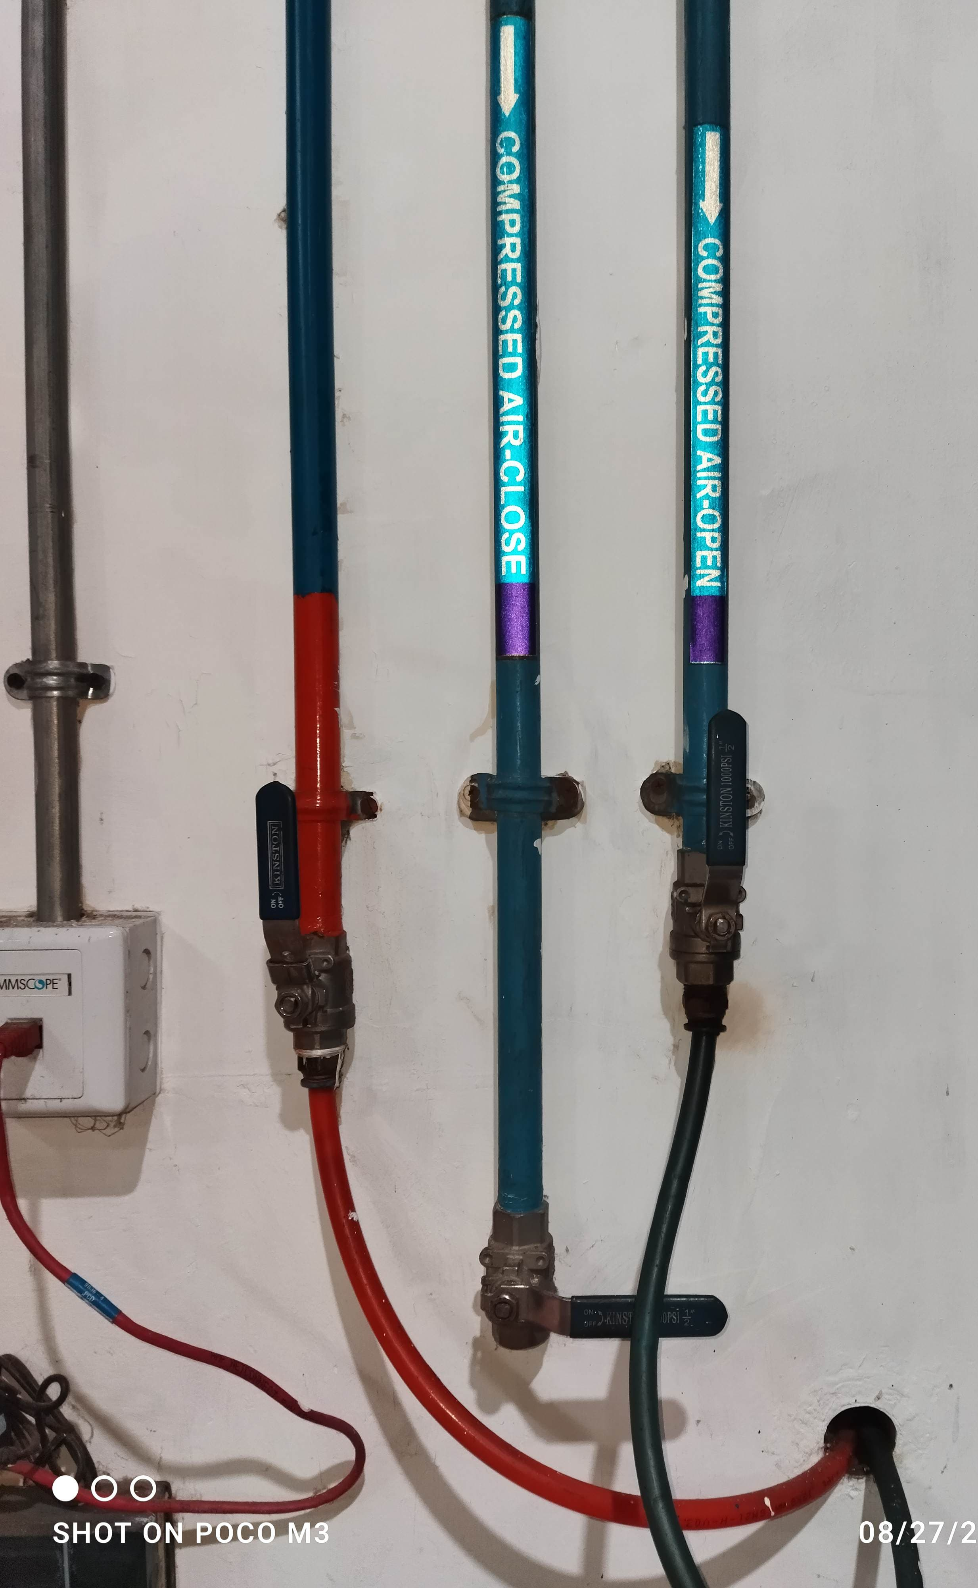
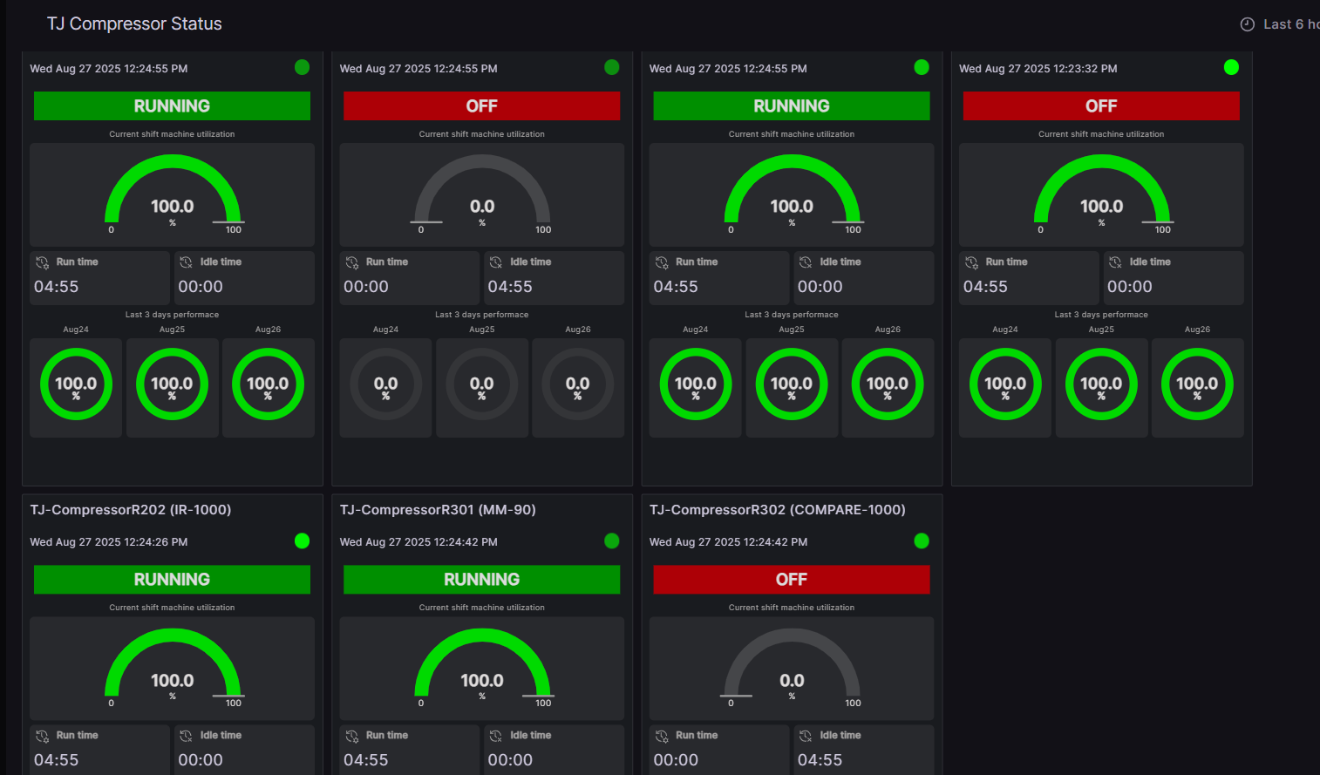
The actions based on AICRSL project support:
Energy management initiatives at Teejay Lanka PLC
Implemented by:
Refurbish pneumatic valve banks to stop leakages and to better manage compressed air supply to dyeing machines
Compressor set point optimization/ leak arresting/ two different colours for open loop & closed loop circuits for easy identification (6 bar & 4 bar)

Slide 9
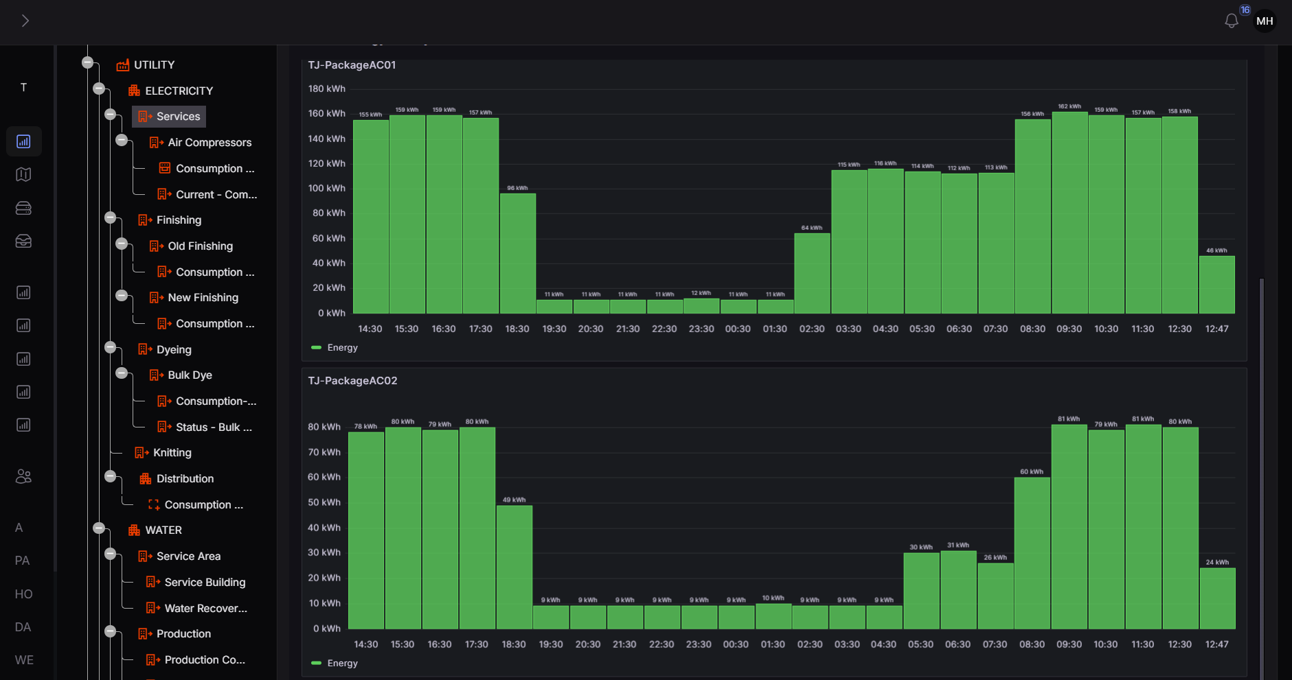
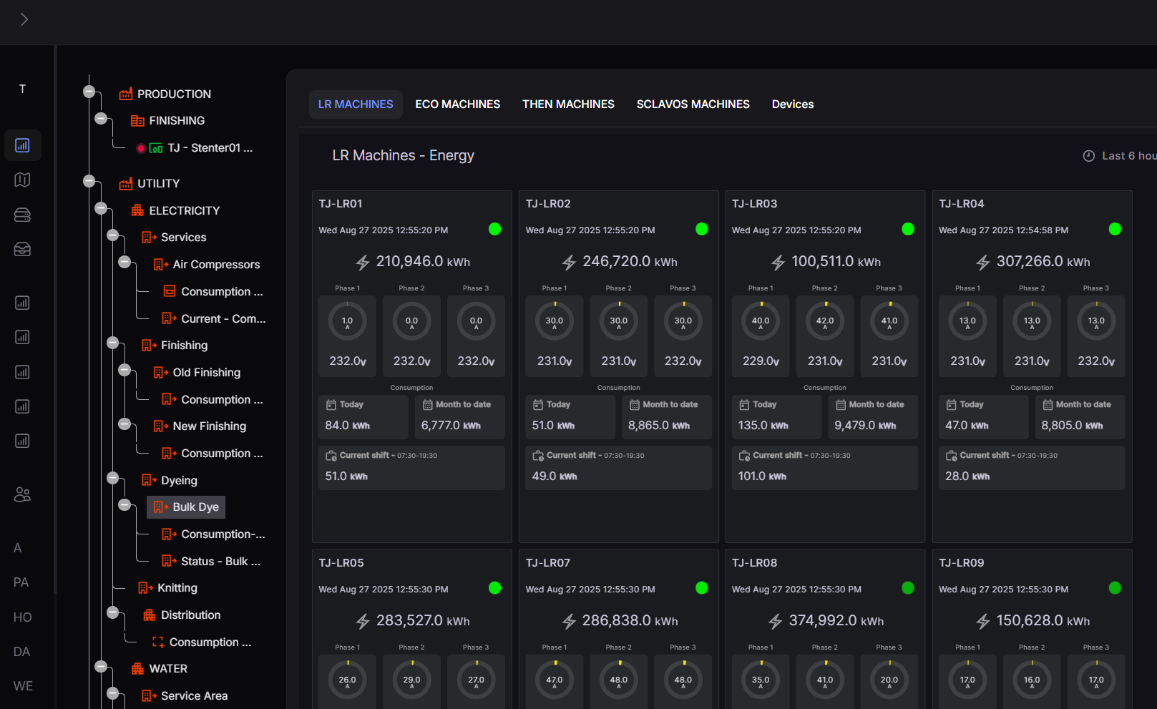
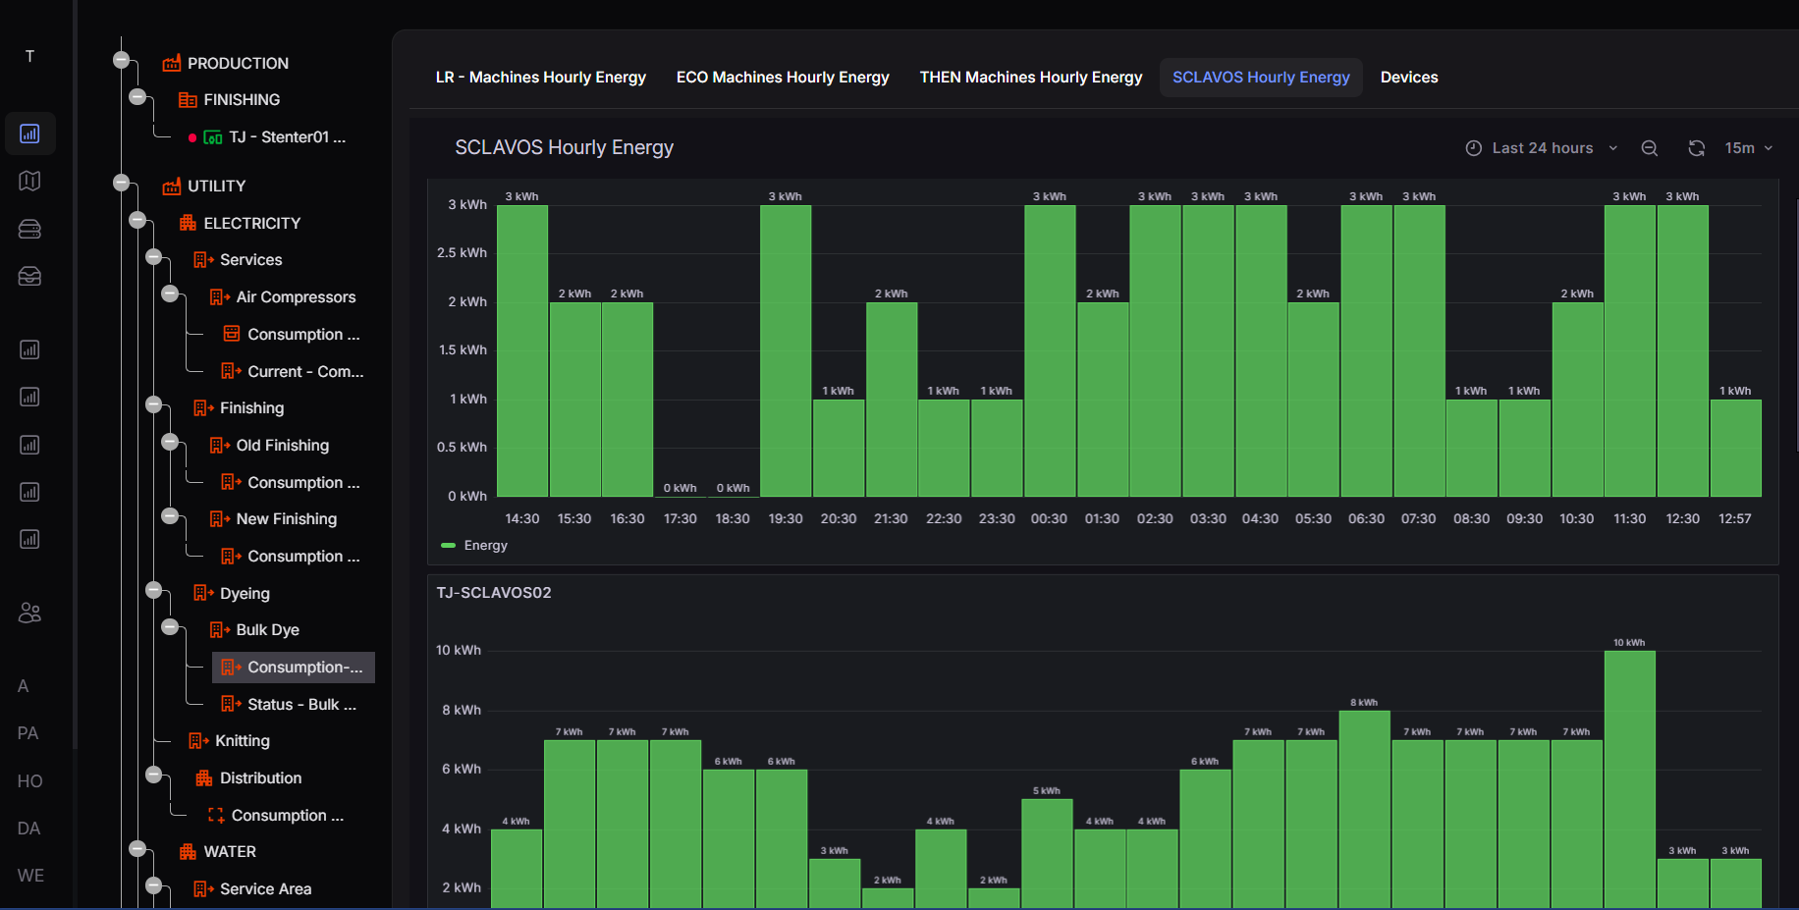
The actions based on AICRSL project support:
Energy management initiatives at Teejay Lanka PLC
Implemented by:
Automated air conditioning system that turns off for 8 hours (only circulation happens
All production machines and utility equipment are connected and monitored for abnormal behaviours. Any discrepancies are addressed immediately

Slide 10
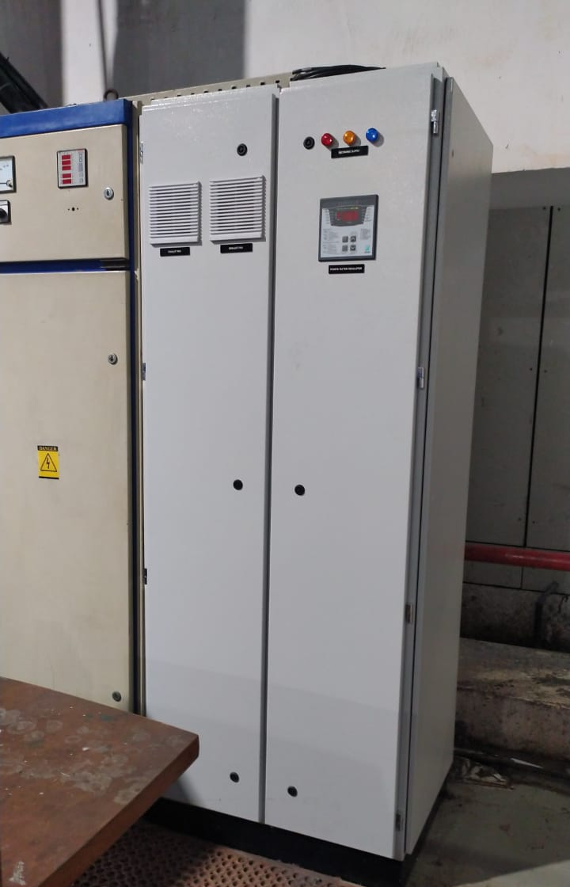
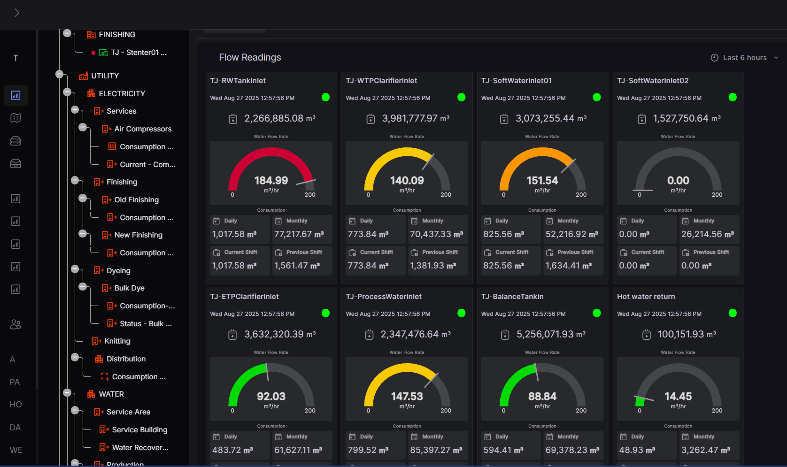
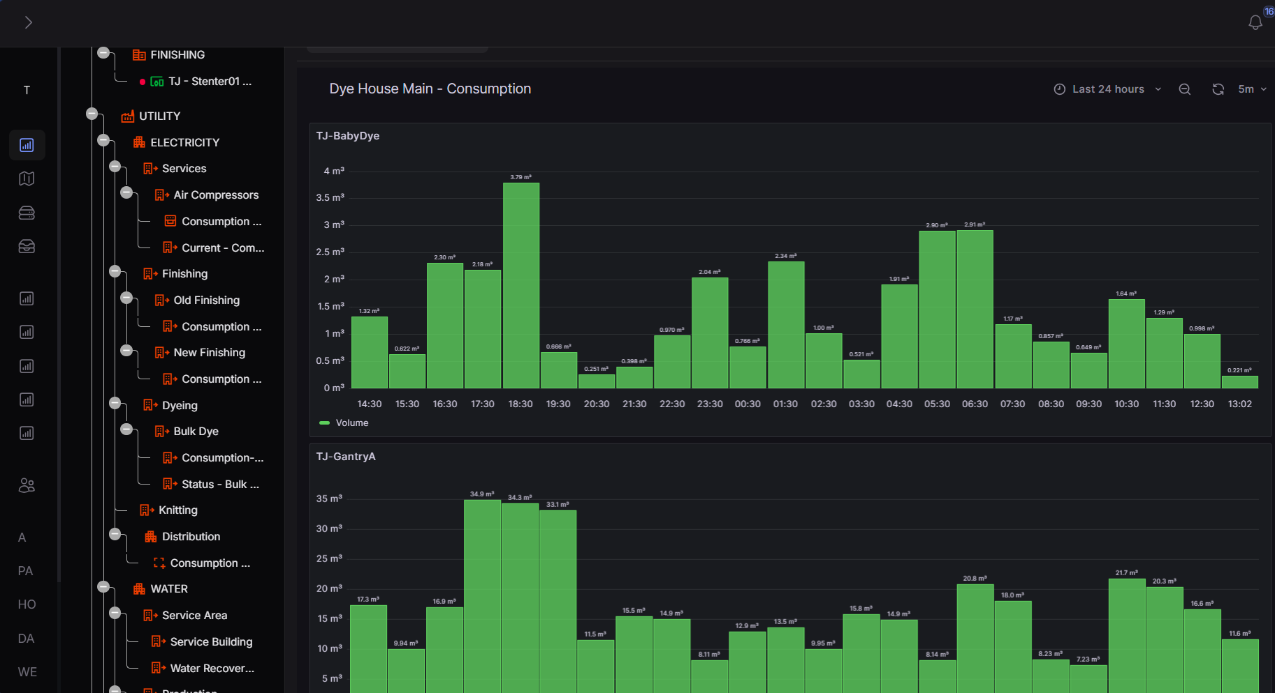
The actions based on AICRSL project support:
Energy management initiatives at Teejay Lanka PLC
Implemented by:
Water consumption is closely monitored for abnormal behaviours. Any discrepancies are addressed immediately
On going capacitor banks replacement for power factor correction

Slide 11
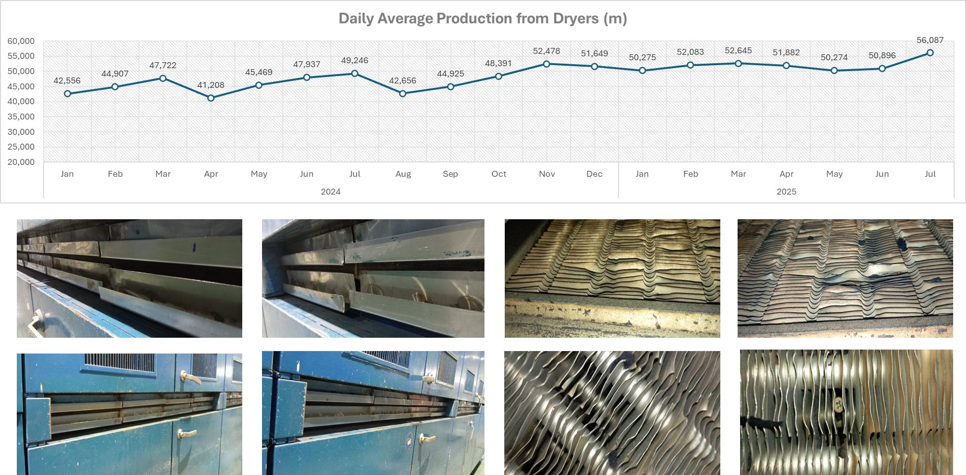
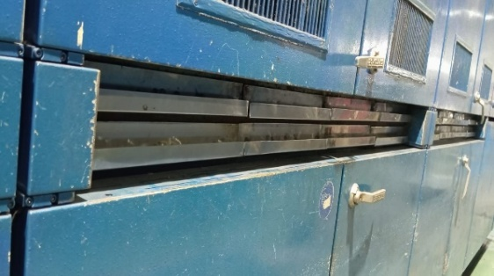
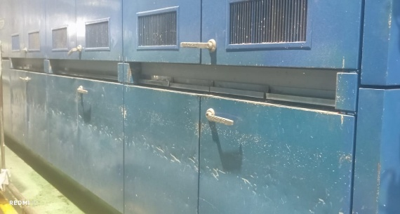
The actions based on AICRSL project support:
Energy management initiatives at Teejay Lanka PLC
Implemented by:
Heating efficiency increase and loss reduction in dryers

Slide 12
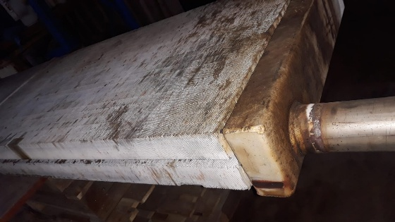
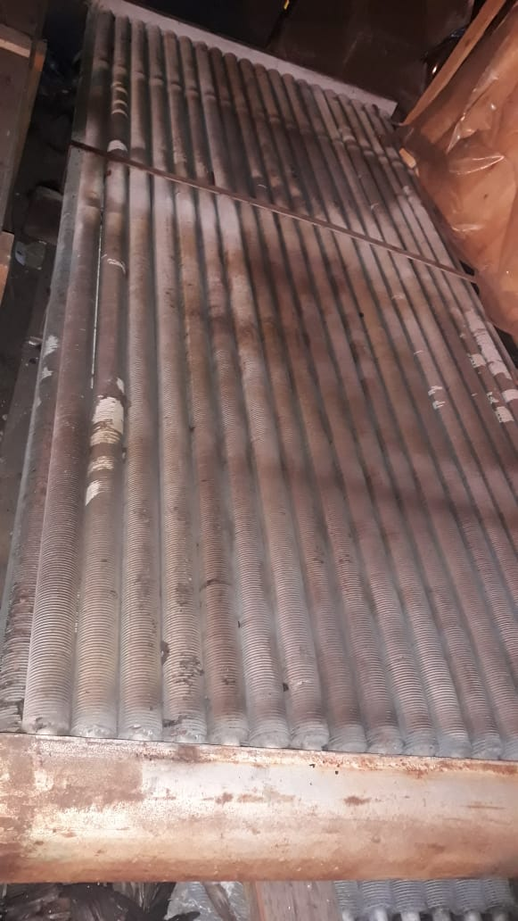
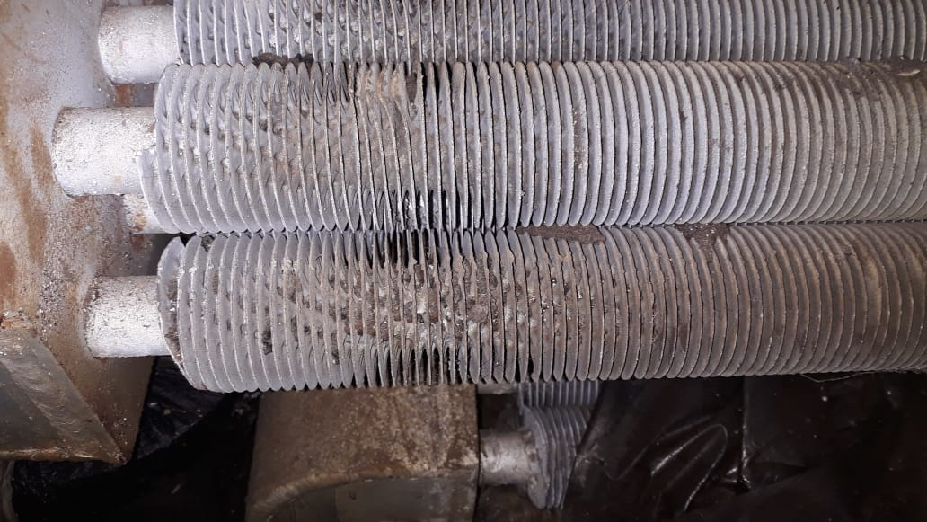
The actions based on AICRSL project support:
Energy management initiatives at Teejay Lanka PLC
Implemented by:
Replaced underperforming heat exchangers in stenters to increase heating efficiency and to enhance energy performance

Slide 13
Benefits and impact:
Intended and un-intended results of EnMS activities
Implemented by:
✅ Intended
💡 Energy efficiency & cost savings
📋 Regulatory & compliance alignment
🌱 Carbon footprint reduction (Scope 1,2, &3)
⚙️ Operational excellence
👥 Employee engagement
⚡ Unintended
🤝 Cultural transformation
💻 Innovation & digitalization push
🏆 Competitive advantage
📈 Financial spin-offs
🔗 Capex justification

Slide 14
Challenges, risks and mitigation action
Implemented by:
Technical
Challenges
Decrease
in orders
Base Load
Management
Integrating old machinery with IoT systems was difficult.
Modbus protocols were used to retrofit
connectivity.
There seems to be a decrease in the orders throughout the textiles industry.
Right-sizing the plant to reduce utility cost.
Utility systems operated at base load even when
production volumes
dropped.
Load balancing and
scheduling changes
were introduced.

Slide 15
Sustainability of EnMS efforts, and way forward
Implemented by:
Utility
dashboards
Weekly &
monthly
reviews
ISO 50001 and
Energy
management
assessment
Utility
optimization &
reduction
Real-time tracking
enables performance
visibility and corrective action.
Teams evaluate energy KPIs
regularly for transparency.
Audits ensure continual
improvement and
compliance.
Standardize processes and develop SOPs.

Slide 16
Thank you:
“What gets measured, can be managed – Teejay continues to lead by turning data into action for energy efficiency, emission reduction, and long-term sustainability.”
Implemented by:

